Slide 1
DEFINITION OF ENCULTURATION
Enculturation refers to the process by which individuals acquire and internalize their particular culture's beliefs, values, norms, customs, traditions, and social behaviors. It is the process through which individuals learn and adapt to the patterns of their society, acquiring the knowledge, skills, and attitudes necessary for their effective participation within that culture.
Enculturation begins early in life and continues throughout an individual's development, primarily through socialization within the family, educational institutions, peer groups, and the broader community. It involves transmitting cultural knowledge and practices from one generation to the next, ensuring the continuity and preservation of a society's customs, language, and way of life.
During enculturation, individuals internalize the cultural norms and values that shape their identity, behavior, and worldview. They learn the appropriate social roles and expectations associated with their gender, age, and social status. This also includes acquiring language and communication patterns and understanding symbols and meanings within a culture.
Fundamental process for the development of social cohesion and the maintenance of cultural traditions. It shapes individuals' beliefs, attitudes, and behaviors, influencing their perspectives, decision-making processes, and interactions within their cultural community.

Slide 2
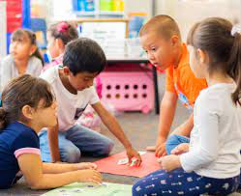
Education in enculturation
"In this captivating photograph, a vibrant tableau of young students engaged in enculturation unfolds before our eyes. The image portrays a bustling classroom setting, teeming with the energy and curiosity of children, each on their unique journey of knowledge acquisition and social integration.

Slide 3
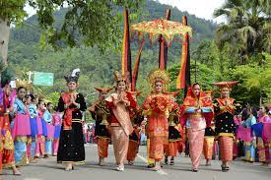
CULTURE IN ENCULTURATION
In this photo capturing a vibrant cultural event, we witness a captivating display of a group of individuals participating in a traditional ceremony passed down through generations. The scene is alive with color, movement, and the spirit of cultural celebration.The focal point of the image is a central stage or performance area adorned with intricate decorations and symbols significant to the represented culture. It serves as the heart of the event, drawing the attention of both participants and onlookers. The stage is embellished with vibrant fabrics, ornate props, and symbolic artifacts, reflecting the rich heritage and values being showcased.

Slide 4
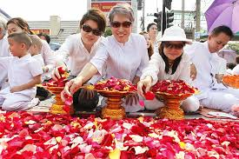
Religion in enculturation
In this thought-provoking photograph, a group of individuals can be seen engaging in a profound religious performance as a means of enculturation.
The image encapsulates the spiritual essence and the significance of faith within their culture.
The photo's focal point is a gathering of devout practitioners, their expressions reflecting a deep sense of devotion and reverence. Dressed in attire that symbolizes their religious affiliation, they embody the customs and traditions passed down through generations.

Slide 5
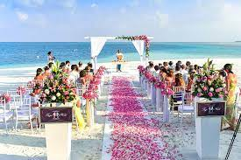
Wedding in enculturation
]
In this enchanting photograph, a blissful scene unfolds as a couple partakes in a wedding ceremony on the sun-kissed shores of a beach, showcasing the fusion of love and celebration.
The image's focal point is the radiant couple standing hand-in-hand amidst a picturesque coastal backdrop. The bride, resplendent in her wedding gown, exudes elegance and beauty, while the groom, donning a dashing suit, emanates joy and anticipation. Their attire might also reflect cultural heritage elements, subtly incorporating traditional motifs or colors.
Surrounding the couple are family members, friends, and loved ones, representing a diverse tapestry of cultures and backgrounds. Each guest may don attire or carry symbols that pay homage to their shared cultural heritage, adding depth and richness to the experience.

Slide 6
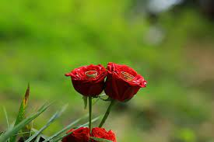
Environment in enculturation
In this captivating photograph, the environment serves as a splendid backdrop for showcasing the regal beauty of the royal rose, intertwining elements of nature.
The image's focal point is an exquisite royal rose, resplendent in its vibrant hues and delicate petals. The rose, often associated with royalty and luxury, symbolizes a rich cultural heritage and carries a deep historical significance.

Slide 7
REFERRENCES
"Enculturation" - Encyclopedia.com: [https://www.encyclopedia.com/social-sciences/encyclopedias-almanacs-transcripts-and-maps/enculturation]
This article on Encyclopedia.com provides a comprehensive overview and its definition, processes, and significance in human development.
"The Process of Enculturation" - Verywell Mind: [https://www.verywellmind.com/enculturation-4175302]
This article from Verywell Mind explores the process of enculturation in detail, discussing how cultural beliefs and practices are transmitted and internalized and how they shape an individual's worldview.

