Slide 1
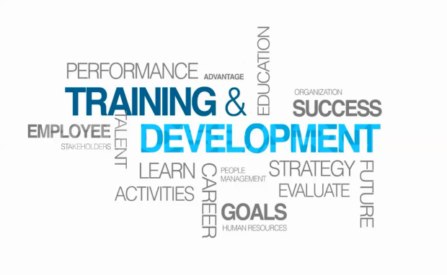
Chapter 7: Training and Development
Denise m. Cobian, PhD

Slide 2
Objectives:
Summarize the purpose and process of employee orientation.
Give an example of how to design onboarding to improve employee engagement.
List and briefly explain each of the five steps in the training process.
Explain how to use five training techniques.
List and briefly discuss four management development methods.
Answer the question, “What is organizational development and how does it differ from traditional approaches to organizational change?”
Explain what to consider in evaluating the effectiveness of a training program.

Slide 3
Introduction:
In this chapter, we will cover:
orienting and onboarding new employees,
employee engagement,
the training process,
implementing training programs,
implementing management development programs,
managing organizational change programs, and
evaluating the training efforts.

Slide 4
Employee Orientation
Employee orientation, or onboarding, provides new employees with the information on the company and job at hand information. The orientation is necessary to get new employees up to speed on what it is that they need to do in their jobs.
Employee orientation should help a new employee start becoming emotionally attached to and engaged in the firm.
Following are the four areas orientation programs attempt to accomplish:
Make the new employee feel welcome.
Make sure the new employee has the basic information.
Help the new employee understand the organization in a broad sense.
Start socializing the person into the firm’s culture and ways of doing things.

Slide 5
The Orientation Program Content (Noe, 2009)
Company Level Information
Company overview (values, history, misión)
Key policies and procedures
Compensation
Employee benefits and services
Safety and accident prevention
Employee and union relations
Physical facilities
Economic factors
Customer relations
Department Level Information
Department functions and philosophy
Job duties and responsibilities
Policies, procedures, rules, and regulations
Performance expectations
Tour of department
Introduction to department employees
Miscellaneous
Community
Housing
Family adjustment

Slide 6
Employment Law
The Employee Handbook
Courts had found that the employee handbook’s contents are legally binding commitments.
Employee handbooks should include a disclaimer stating “nothing in this handbook should be taken as creating a binding contract between employer and employees…”
Employee handbooks should not have language that implies that employees have tenure.
Orientation Technology: used to support orientation programs. May include employer’s mission statement, organization policies and procedures, and others.
Training decisions: be careful when you decide who’s will be trained (Title VII any other antidiscrimination law). EEOC stresses that employers should provide training to all employees to ensure they understand their rights and responsibilities.

Slide 7
What is training and why is so important?
Directly after the initial orientation, training should begin.
Training is the process of teaching new or current employees the basic skills they need NOW to perform their jobs.
Training is an extremely important endeavor that companies must do well.
Negligent training is a situation where an employer fails to train adequately, and the employee subsequently harms a third party.

Slide 8
The ADDIE Five-Step Training Process
Analyze the training need
The gold standard is still the basic analysis-design-develop-implement-evaluate or ADDIE (Analyze, Design, Develop, Implement, Evaluate) training process model that training experts have used for years. The steps are as follows:
Design the overall training program
Develop the course
Implement training by targeting employee groups using methods
Evaluate the course’s effectiveness

Slide 9
Aligning strategy and training
The employer’s strategic plans should govern its training goals. In essence, the aim is to identify the employee behaviors the firm will need to execute its strategy, and from that, deduce what competencies employees will need (Dessler, 2019).
Giving employees opportunities to learn and develop creates a positive work environment, which supports the business strategy by attracting talented employees as well as motivating and retaining current employees (Noe, 2009).

Slide 10
Causes and outcomes of needs assessment (Noe, 2009)
In what do they need training?
Reasons or pressure points
Legislation
Lack of basic skills
Poor performance
New technology
Customer requests
New products
Higher performance standards
New jobs
What is the context?
Organizational analysis
Person analysis
Task analysis
Outcomes
What trainees need to learn
Who receives training
Type of training
Frequency of training
Buy vs. Build training decisión
Training vs. Other HR options
How training should be evaluated
Who needs training?

Slide 11
Conducting the Training Needs Analysis
The training needs analysis may address the employer’s strategic/long-term training needs and/or its current training needs.
Strategic Training Needs Analysis: identifies the training employees will need to fill these new future jobs.
Current Training Needs Analysis: consists in determining whether training is the solution for each problem.

Slide 12
Task Analysis: Analyzing New Employees’ Training Needs: is a detailed study of a job to identify the specific skills required.
Talent Management: Using Competency Models: is a graphical model that consolidates in one diagram a precise overview of the competencies (the knowledge, skills, and behaviors) someone would need to do a job well.
Performance Analysis: Analyzing Current Employees’ Training Needs: is verifying that there is a performance deficiency and determining whether that deficiency should be corrected through training or through some other means (such as transferring the employee).
Notes:
Some managers supplement the job description and specification with a task analysis record form. This form consolidates information regarding required tasks and skills.
Instructional design is designing, creating, and developing formal learning solutions to meet organizational needs; analyzing and selecting the most appropriate strategy, methodologies, and technologies to maximize the learning experience or impact.
Performance analysis begins with comparing the person’s actual performance to what it should be.

Slide 13
The needs assessment process
Person analysis
Person characteristics
Imput/Output
Consequences
Feedback
Task analysis or competency model
Work activity (task)
Knowledge, skill, ability, personal capability (competency)
Conditions under which tasks are performed
Organizational analysis
Strategic direction
Support of managers, peers, and employees for training activities
Training resources
Do we want to devote time and money for training?

Slide 14
Ways to Identify How Current Employees are Doing
Performance appraisals
Job-related performance data
Observations by supervisors or other specialists
Interviews with the employee or his/her supervisor
Tests of job knowledge, skills, and attendance
Attitude surveys
Individual employee daily diaries
Assessment center results
Special performance gap analytical software

Slide 15
Designing the Training Program
Design means planning the overall training program, including objectives, delivery methods, and program evaluation.
Parts of a training program:
Objectives refer to the purpose and expected outcome of training activities (Noe, 2009). The objectives must consider:
What the employee is expected to do
The quality or level of performance that is acceptable
The conditions under which the trainee is expected to perform the desired outcome.
Delivery methods: seminar, conference, workshop, case studies, role plays, experiential learning activities, discussion, simulations, games, observations, others.
Audience: who should attend and group size.
Participant preparation: identify pretraining assignments.
Instructional materials and aids: documents, equipment, media.
Program evaluation: reference list, facility checkoff list.

Slide 16
Developing the program
Development: (assembling the program’s training content and materials).
Implementation (provide the training, using one or more of the instructional methods).
Evaluation (collecting the outcomes needed to determine whether training is effective).

Slide 17
Implementing the Training Program
On-the-Job training means training a person to learn a job while working on it. The most familiar on-the-job training is the coaching or understudy method. Other types include job rotation, special assignments, or peer training.
Apprenticeship training is a structured process by which people become skilled workers through a combination of classroom instruction and on-the-job training.
Informal learning involves employees that facilitate their own informal learning.

Slide 18
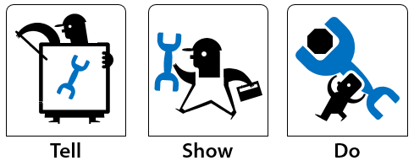
Types of Training/Instructional or Delivery Methods
Seminars
Conferences
Workbooks and manuals
Instructor-led classroom
Virtual classroom
Video conference
Web-based self study
Role play (hands on workshops)
Case study
Games
Simulations
Experiential programs
Observations
Mental imagery
Writing
Lectures
Small group discussions
Task exercises
Behavior modeling
Vestibule training
Job aids
Mobile learning
Notes:
Many jobs consist of a sequence of steps best learned step-by-step. Job Instruction training (JIT) is listing each job’s basic tasks, along with key points, in order to provide step-by-step training for employees.
Programmed learning is a systematic method for teaching job skills, involving presenting questions of facts, allowing the person to respond, and giving the learner immediate feedback on the accuracy of his or her answers.

Slide 19
Training
Web 2.0 learning is learning that utilizes online technologies such as social networks, virtual worlds (such as Second Life), and systems that blend synchronous and asynchronous delivery with blogs, chat rooms, bookmark sharing, and tools such as 3-D simulations.
Lifelong learning provides employees with continuous learning experiences over their tenure with the firm, with the aims of ensuring they can learn the skills they need to do their jobs and to expand their occupational horizons.
Literacy training is becoming more important as an estimated 39 million people in the U.S. have learning disabilities. Basic skills such as writing and speaking can be trained by giving employees exercises to work.
Diversity training is very common in companies since aims to improve cross-cultural sensitivity, with the goal of fostering more harmonious working relationships among a firm’s employees.

Slide 20
Team Training
Cross training involves training employees to do different tasks or jobs than their own; doing so facilitates flexibility and job rotation.
Technical training involves employees being encouraged to learn each other’s jobs and to encourage flexible team assignments.
Interpersonal skills training such as listening, handling conflict, decision making, problem solving, and negotiating.

Slide 21
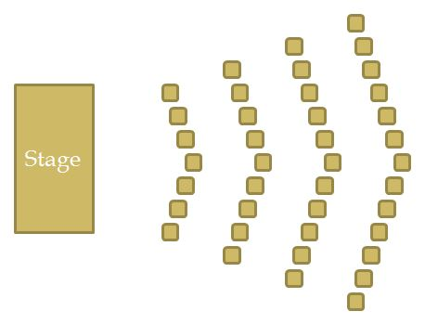
Delivering training: Seating arrangements
Classroom style
Horseshoe
Single square or round
Cluster
Conference
Semicircle or full circle
Chevron

Slide 22
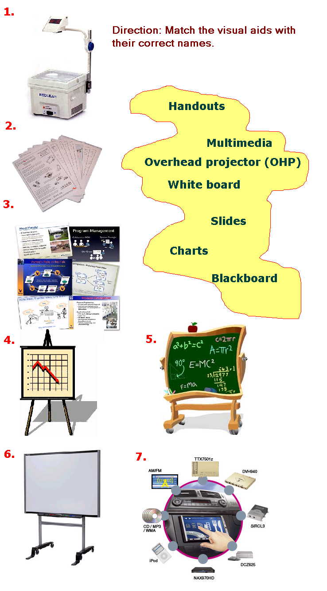
Using visual aids
To capture attention
To reinforce points
To organize information
To promote understanding
To support the spoken message
To emphasize key points

Slide 23
Implementing Management Development Programs
Management development method is any attempt to improve current or future management performance by imparting knowledge, changing attitudes, or increasing skills.
Strategy’s Role in Management Development (should reflect firm’s strategic plans)
Succession Planning/Succession Systems (identify, assess, develop organizational leadership)
Candidate Assessment and the 9-Box Grid (shows potential vs. performance)
Managerial On-the-Job Training includes:
Job Rotation
Coaching/Understudy Approach
Action Learning
Notes:
Management development is important for several reasons. For one thing, promotion from within is a major source of management talent, and virtually all promoted managers require some development to prepare them for their new jobs. Furthermore, management development facilitates organizational continuity, by preparing employees and current managers to smoothly assume higher level positions.
Management development programs should reflect the firm’s strategic plans. Some management development programs are companywide and involve all or most new managers. Other development programs aim to fill specific top positions, such as a CEO.
Succession planning is the ongoing process of systematically identifying, assessing, and developing organizational leadership to enhance performance. Succession planning requires assessing these candidates and selecting those who will actually fill the key positions.
A succession system can allow managers to access the program via the Web using a password. Managers can fill out online resumes for themselves, including career interests, and not special considerations such as geographic restrictions.
The 9-Box Grid is one tool to assess candidates. It shows potential from low to medium to high on the vertical axis, and performance from low to medium to high across the bottom—a total of nine possible boxes.
Managerial on-the-job training methods include job rotation, the coaching understudy approach, and action learning.
Job rotation means moving managers from department to department to broaden their understanding of the business and to test their abilities.
In a coaching or understudy approach, trainees work directly with a senior manager or with the person he or she is to replace; the latter is responsible for the trainee’s coaching.
Action learning programs give managers released time to work analyzing and solving problems in departments other than their own.

Slide 24
Off-the Job Management Training
The Case Study Method
Management Games
Outside Seminars
University-Related Programs
Role Playing
Corporate Universities
Executive Coaches
Notes:
The case study method is a development method in which the manager is presented with a written description of an organizational problem to diagnose and solve. Integrated case scenarios create long-term, comprehensive case situations.
Management games are computerized and are a development technique in which teams of managers compete by making computerized decisions regarding realistic but simulated situations.
Outside seminars are common training venues to send employees to and are either Web-based or the traditional classroom or conferences.
Many universities provide executive education and continuing education programs in leadership, supervision, and the like.
Role playing is a training technique in which trainees act out parts in a realistic management situation.
Corporate Universities are an in-house development center that is a company-based method for exposing prospective managers to realistic exercises to develop improved management skills.
Executive Coaches are outside consultants who question the executive’s associates in order to identify the executive’s strengths and weaknesses, and then counsels the executive so he or she can capitalize on those strengths and overcome the weaknesses.

Slide 25
“What is organizational development and how does it differ from traditional approaches to organizational change?”
Organizational development is a special approach to organizational change in which employees themselves formulate and implement the change that’s required.
There are many ways to reduce resistance among employees concerning change. Consider this if you want to promote organization change at work.
Establish a sense of urgency
Mobilize commitment
Create a guiding coalition
Develop and communicate a shared vision
Help employees make the change
Aim first for attainable short-term accomplishments
Reinforce the new ways of doing things
Monitor and assess progress

Slide 26
Evaluating the effectiveness of a training program
The manager can measure four types of training outcomes or effects:
Reaction. Evaluate the trainees’ reactions to the program.
Learning. Test the trainees to determine whether they learned the principles, skills, and facts they were supposed to learn.
Behavior. Ask whether the trainees’ on-the job behavior changed because of the training program.
Results. Know what results you want to achieve and terms of the training objectives.

Slide 27
Example Training Evaluation Form (Dessler, 2019)

Slide 28
Summary
The goal of training is for employees to master the KSAB emphasized in training programs and to apply them to their day-to-day activities.
For companies trainings are needed to gain a competitive advantage and to create intellectual capital.
See this video about Training (HRM) at https://www.youtube.com/watch?v=dyMckGTRZD0

Slide 29
References:
Dessler, G. (2019). Fundamentals of Human Resource Management. (5th ed.). Upper Saddle River, NJ: Pearson.
Lawson, K. (2009). The Trainer’s Handbook. (Updated edition). San Francisco, CA: Pfeiffer/Wiley.
Noe, R. A. (2009). Employee Training and Development. (4th ed.). New Delhi, India: TataMcGrawHill.

