Slide 1
FA265 Business Ethics and Corporate Governance
Lecture 4: Making Decisions in Business Ethics Descriptive Ethical Theories
Dr Solomon Akpotozor

Slide 2
Pre-lecture reading:
Chapter 4, Making Decisions in Business Ethics: Descriptive Ethical Theories
(in Business Ethics, 5th Ed. by Crane et al., 2019)

Slide 3
Learning Objectives
At the end of the lecture, you should be able to
Explain why ethical and unethical decisions get made in the workplace.
Specify the characteristics of a decision with ethical content.
Understand a basic ethical decision-making model and delineate key elements of individual and situational influences on ethical decision-making.
Critically evaluate the role of individual differences in shaping ethical decision-making.
Critically evaluate the role of situational influences on ethical decision-making, including both issue-based and context-based factors.
Identify points of leverage for improving ethical decision-making in business.

Slide 4
Overview
Examine the question of why ethical and unethical decisions get made in the workplace
Determine what an ethical decision is
Review prominent ethical decision-making models
Discuss the importance of differences between individuals in shaping ethical decision-making
Critically evaluate the importance of situational influences on ethical decision-making (issues and context based)
Identify points of leverage for managing and improving ethical decision-making in business

Slide 5
Madoff case: the biggest fraud in the American history, ever!
Link: https://www.youtube.com/watch?v=IlFdZT275Ak

Slide 6
Descriptive Ethical Theories
Descriptive business ethics theories seek to describe how ethics decisions are actually made in business, and what influences the process and outcomes of those decisions.
Notes:
Why do some business people make what appear to be the right ethical choices, whilst some do things that are unscrupulous or even illegal?
Are people who make these unethical decisions inherently bad, or are there other reasons that can explain the incidence of ethics problems in business?
Do people have different ethical beliefs and values at work from those they have at home?
This lecture provides a way of addressing these questions by examining what are called descriptive ethical theories.
Descriptive ethical theories provide an important addition to the normative theories covered in the previous chapter: rather than telling us that business people should do (normative theory), descriptive theories seek to tell us what business people actually do – and more importantly, why they do it

Slide 7
Main factors in deciding the moral status of a situation
Decision likely to have significant effects on others
Decision likely to be characterised by choice, in that alternative courses of action are open
Decision is perceived as ethically relevant by one or more parties

Slide 8
Models of ethical decision-making

Slide 9
Perspectives on ethical decision-making
Schwartz (2016) distinguishes between two types of ethical decision making.
Rationalist perspective – very common approach that assumes a logical reasoning approach, akin to a calculation being done, prior to arriving at an ethical judgement
Intuitionist/sentimentalist perspective – considers role of cognitive processes and intuition, emotion or sentiment, particularly important is the role of quick moral intuitions

Slide 10
Stages in ethical decision-making
Ethical decision-making process
Recognise moral issue
Make moral judgement
Establish moral intent
Engage in moral behaviour
Source: Derived from Rest (1986), as cited in Jones (1991).

Slide 11
Framework for understanding ethical decision-making
Individual factors
Recognise moral issue
Make moral judgement
Establish moral intent
Engage in moral behaviour
Situational factors

Slide 12
Individual influences on ethical decision-making

Slide 13
Individual influences on ethical decision-making
Age and gender
National and cultural characteristics
Education and employment
Psychological factors
Personal values
Personal integrity
Moral imagination
Research finds that business students have lower moral development and were more likely to engage in academic cheating (plagiarism) then other students. Do you believe it?

Slide 14
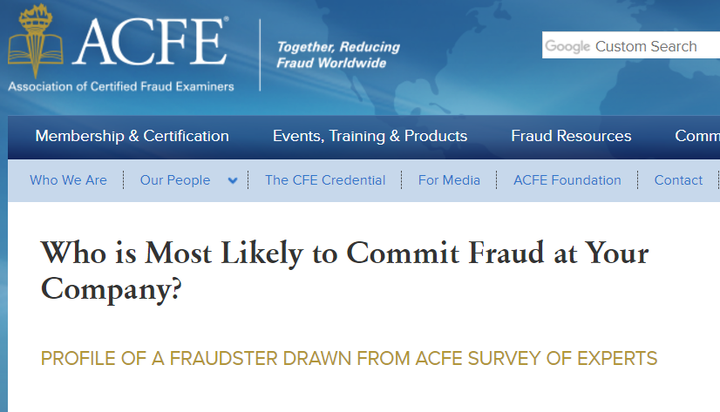
Who is most likely to manipulate financial statements?
More than half of all cases in the study were committed by individuals between the ages of 31 and 45.

Slide 15
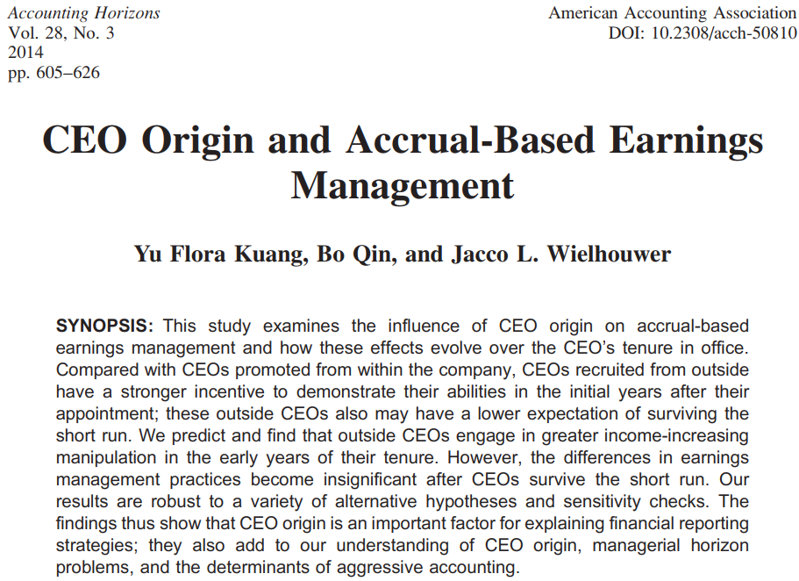
Research evidence

Slide 16
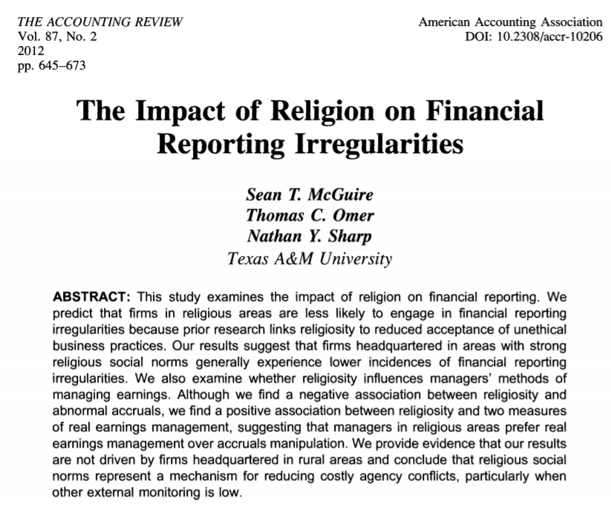
Research evidence

Slide 17
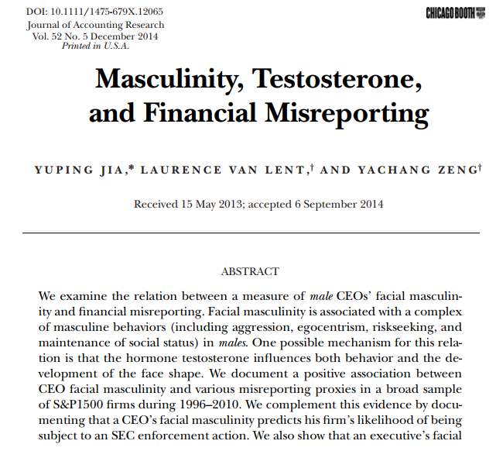
Research evidence

Slide 18
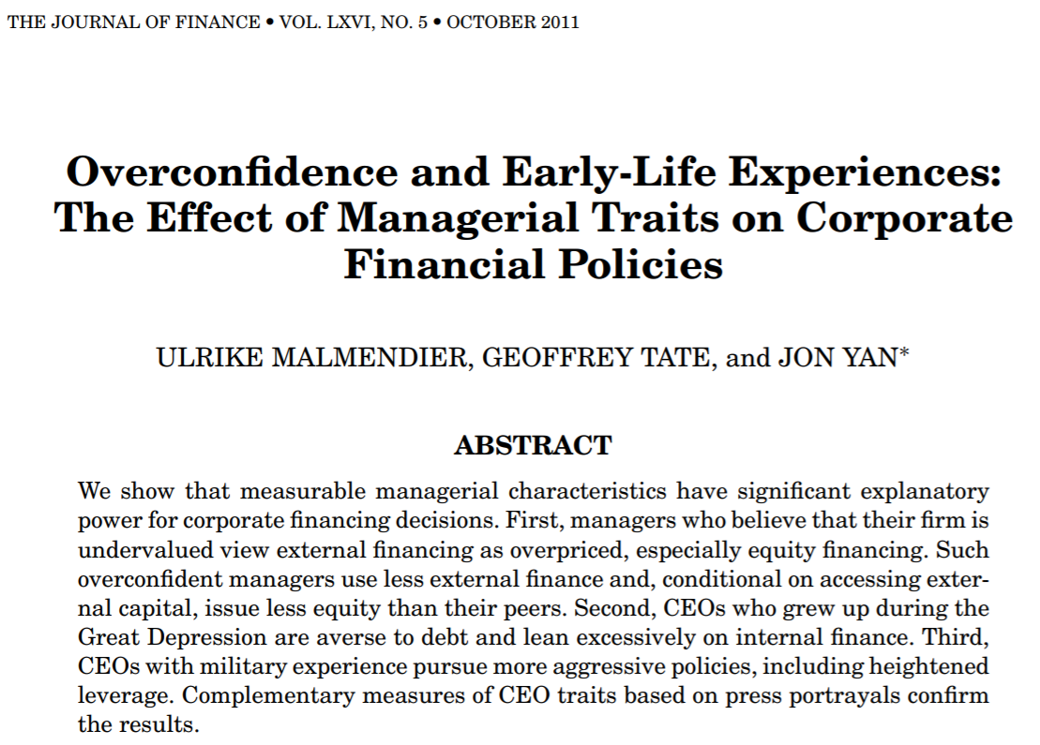
Research evidence

Slide 19
Situational influences on decision-making

Slide 20
Situational influences on decision-making
Moral intensity
Moral framing
Moral muteness
Whistleblowing
Systems of reward
Authority and Bureaucracy
Work roles
Organizational norms and culture
National and cultural context

Slide 21
CEO profile as risk indicators (Nguyen et al. 2017)
1) Has lots of role experience in company?
2) Has working experience as a chief financial officer?
3) Has finance-related qualification?
4) Has joined the company recently?
5) Has performed well in recent year?
6) Has been extensively mentioned in media recently?
7) Is the chairman?
8) Is a founder?
9) Is young or close to retirement?
10) Is married?
11) Is female?

Slide 22
Summary
In this lecture we have:
Discussed the various stages of and influences on ethical decision-making in business
Presented basic model of decision-making
Outlined individual and situational influences on ethical decision-making
Next lecture reading:
Chapter 6 & 7, Shareholders, Employees and Business Ethics
(in Business Ethics, 5th Ed. by Crane et al., 2019)

