Slide 1
FA265 Business Ethics and Corporate Governance
Lecture 3: Evaluating Business Ethics Normative Ethical Theories
Dr Solomon Akpotozor

Slide 2
Pre-lecture reading:
Chapter 3, Evaluating Business Ethics: Normative Ethical Theories
(in Business Ethics, 5th Ed. by Crane et al., 2019)

Slide 3
Learning Objectives
At the end of the lecture, you should be able to
Explain the role of normative ethical theory for ethical decision-making in business.
Understand and apply Western modernist ethical theories, i.e. utilitarianism, ethics of duty, rights and justice, and social contract theory.
Understand and apply alternative ethical theories, i.e. virtue ethics, ethic of care, discourse ethics, and postmodernism.
Conduct a pluralist business ethics evaluation.

Slide 4
Overview
Locate the role of ethical theory
Highlight international differences in perspectives
Provide critical overview of traditional ethical theories
Explore contemporary ethical theories

Slide 5
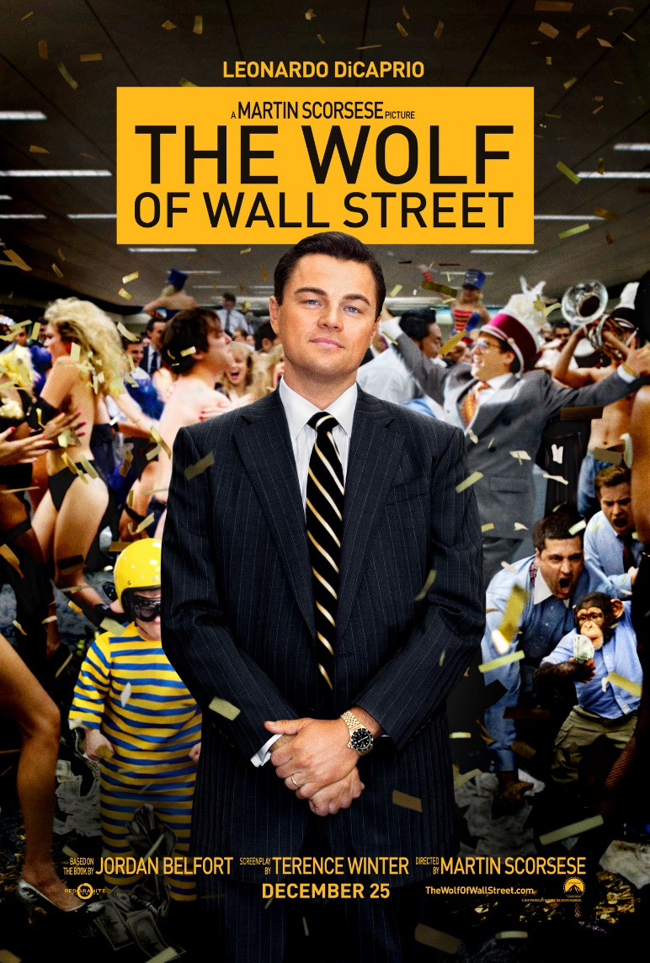
How to evaluate business ethics?
The Wolf of Wall Street is a 2013 American biographical black comedy crime film directed by Martin Scorsese and written by Terence Winter, based on the memoir of the same name by Jordan Belfort.
In 1987, Jordan Belfort (Leonardo DiCaprio) procures a job as a Wall Street stockbroker for L.F. Rothschild, employed under Mark Hanna, who quickly entices him with the careless sex and drugs fueled stockbroker culture and passes on his idea that a stockbroker's only goal is to make money for himself… (Wikipedia)
https://www.youtube.com/watch?v=idOQXlHVrQE

Slide 6
THE ROLE OF ETHICAL THEORY [Crane, Andrew/Matten, Dirk/Glozer, Sarah. Business Ethics]
Ethical absolutism: on one side of the spectrum, ethical absolutism claims that there are eternal, universally applicable moral principles.
This means right and wrong are objective qualities that can be rationally determined, irrespective of the circumstances.
Ethical relativism: on the other side of the spectrum, ethical relativism claims that morality is context-dependent and subjective, e.g. due to cultural differences.
relativists tend to believe that there are no universal right and wrongs that can be rationally determined - it simply depends on the traditions, convictions, or practices of those making the decision.

Slide 7
Normative ethical theories

Slide 8
What are normative ethical theories?
Ethical theories are the rules and principles that determine right and wrong for any given situation
Normative ethical theories are those that propose to prescribe the morally correct way of acting
As opposed to descriptive ethical theories which seek to describe how ethics decisions are actually made in business

Slide 9
Western modernist ethical theories

Slide 10
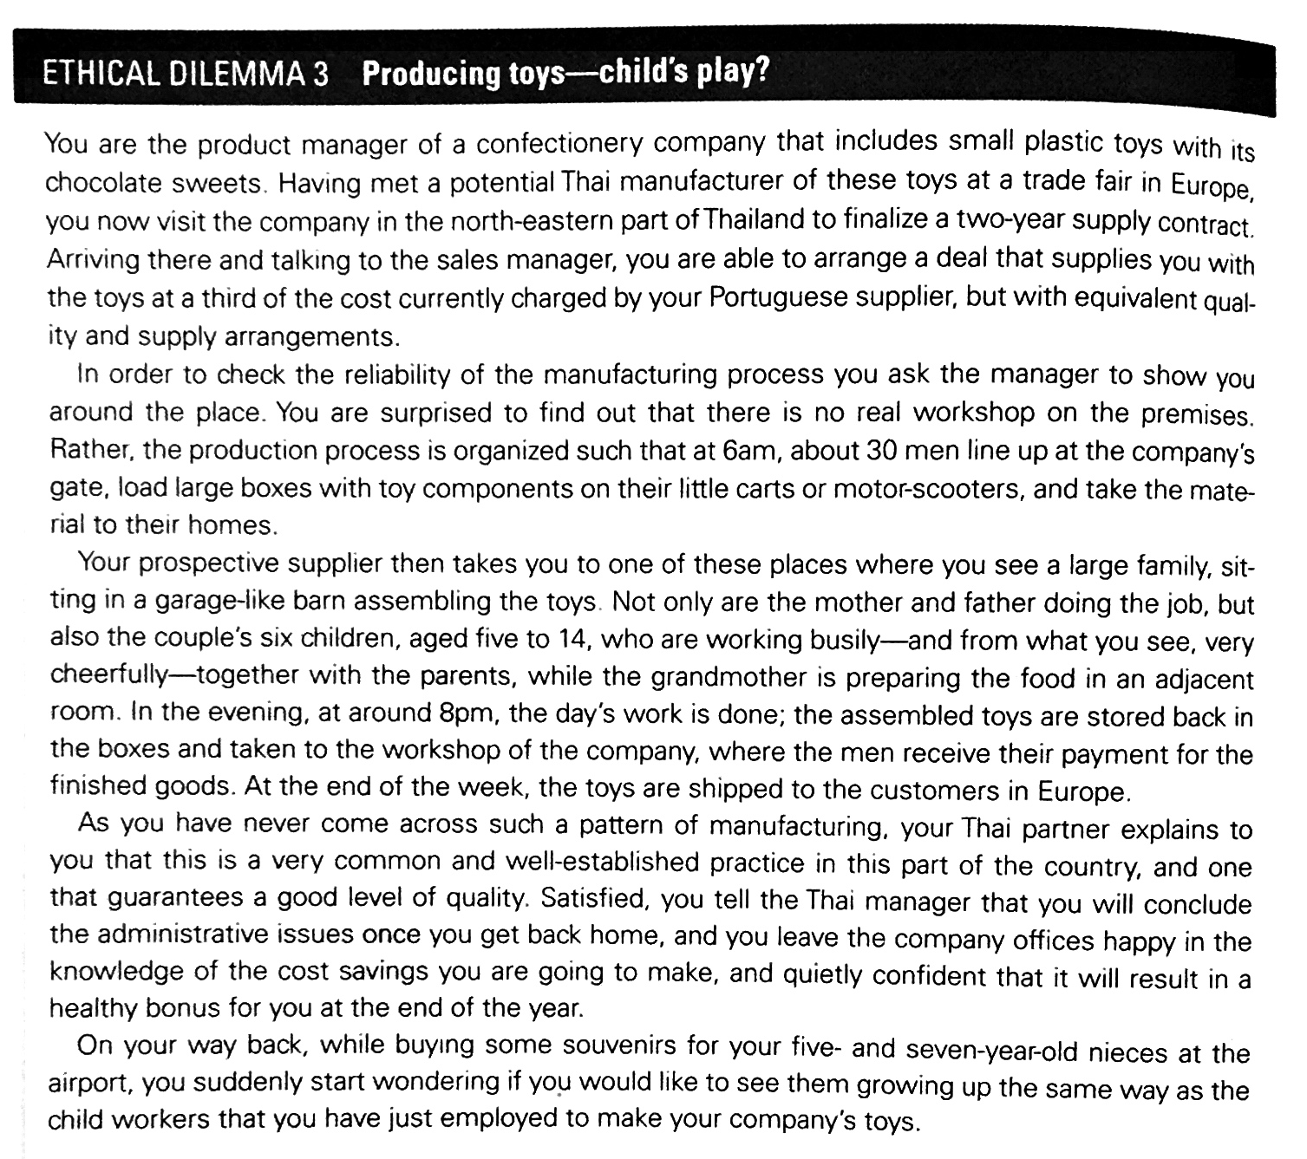

Slide 11
Traditional ethical theories
Generally offer a certain rule or principle which one can apply to any given situation
These theories generally can be differentiated into two groups
Motivation/
Principles
Action
Outcomes
Non-consequentialist Ethics
Consequentialist Ethics
Source: Crane et al (2019)

Slide 12
Egoism (Individualism)
Ethical egoism - an action is morally right if the decision-maker freely decides an action to pursue either their (short-term) desires or their (long-term) interests.
Perhaps most widely known in the guise of Adam Smith’s (1793): pursuit of individual interest morally acceptable as invisible hand of market creates benefit for all
Friedman (see Lecture 2) promoted the idea that the responsibility of the business leader is to fulfil fiduciary duties to shareholders (maximize shareholders’ wealth, not society’s wealth).

Slide 13
Utilitarianism (Happiness vs Unhappiness)
According to utilitarianism, an action is morally right if it results in the greatest amount of good for the greatest number of people affected by the action
Also called the ‘greatest happiness principle’
Based on cost-benefit analysis
Evaluate benefits (pleasure/happiness) for one group of stakeholders and costs (pain/unhappiness) for the other group
Mining activities may benefit their companies’ shareholders and employees, but damage local community and the environment.

Slide 14
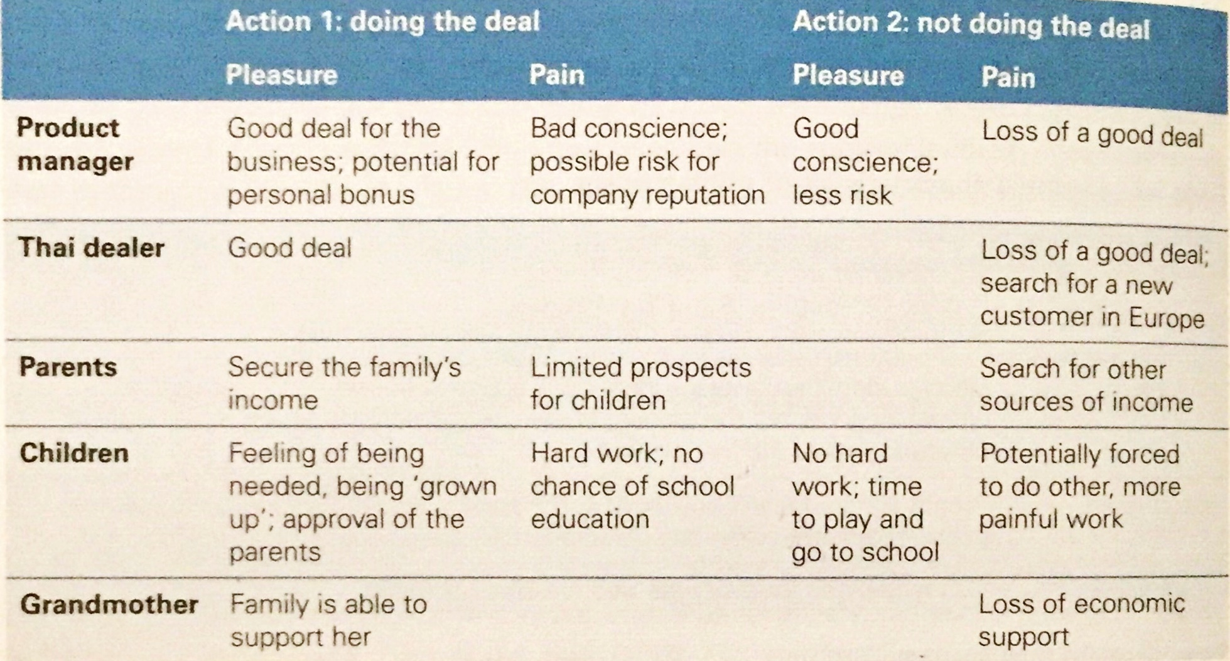
Producing toys with child labour
Ethical dilemma 3, page 94

Slide 15
Problems with Utilitarianism
Subjectivity
Depends on subjectivity of the person carrying out analysis
Does the child receive an equal weighting?
How to quantify children’s loss in education?
Are animals included in analysis?
Greta Thunberg (see Lecture 2) talked about “a stolen future”. Are future generations taken into account?
This has led to refinement of theory
Act utilitarianism, which looks at single action
Rule utilitarianism, which looks at multiple actions

Slide 16
Ethics of duties
Ethical theories that consist of abstract, unchangeable obligations, defined by a set of rationally deduced a priori moral rules, which should be applied to all relevant ethical problems
For instance, child labour:
Is it universally accepted when companies are exploring child labour?
Is basic human dignity fully recognized and respected?

Slide 17
Problems with ethics of duties
Undervaluing outcomes
the theory is based on duty, not outcome
Undervaluing motivation
Failing to motivate in circumstances when managers are willing to do or are obligated to do
Life is more complicated than self-imposed duties

Slide 18
Ethics of rights and justice
Human rights
Basic, inalienable entitlements that are inherent to all human beings, without exception.
Based on consensus about nature of human dignity.
Increasingly important: enshrined in principles of UN Global Compact and the “Ruggie Principles”.
Justice
The simultaneously fair treatment of individuals in a given situation with the result that everybody gets what they deserve
Fair procedures (procedural justice)
Fair outcomes (distributive justice)

Slide 19
Limits of traditional Western Modernist ethical theories
Too abstract (that is, too general)
Too reductionist (that is, they are more complex than presented)
Too objective and elitist
Too impersonal
Too rational and codified
Too imperialist

Slide 20
Alternative perspectives on ethical theory

Slide 21
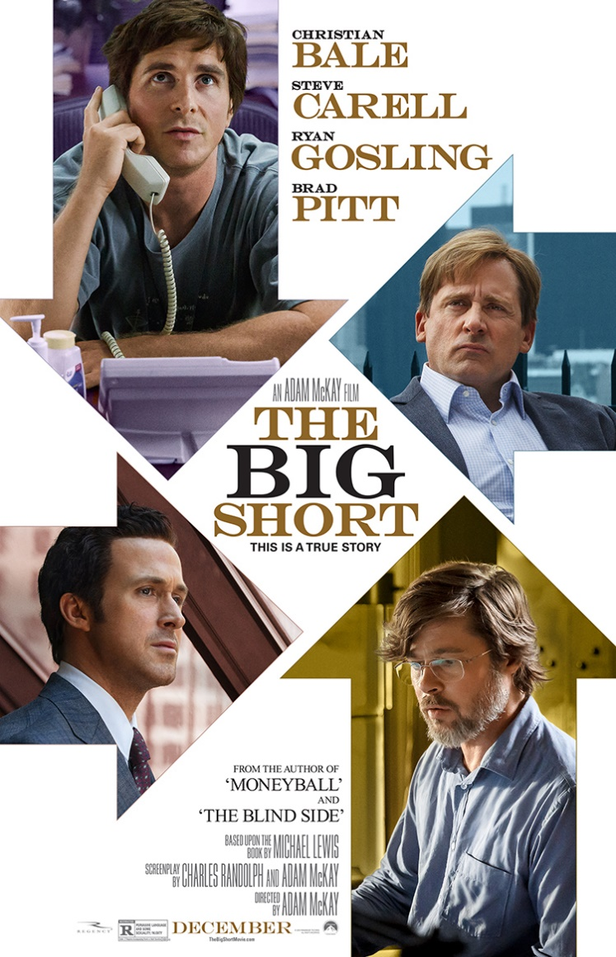
Is making money on financial crash ethical?
The Big Short, released in 2015, is a Hollywood drama which provides shocking insight into the 2008 financial crash and the handful of individuals who not only saw it coming, but profited immensely from it. It follows the discovery of the fragility of the market by a hedge fund manager, and his creation of the infamous credit default swap, as well as those who stumbled on what he had discovered and, as a result, bet against the market. These stories are told in the context of the apparently thriving US financial system that is in fact cracking beneath the surface, which is gradually revealed during film, and culminates in the widespread financial devastation of the 2008 crash. The film both implicitly and explicitly deals with a number of ethical dilemmas and issues, such as the amorality of Wall Street and the world of finance, the human consequences of corporate and individual greed and the consequences of regulatory failure, as well as that of other bodies, for example ratings agencies.
https://www.youtube.com/watch?v=xbiDrzTd8fE

Slide 22
Alternative perspectives on ethical theory
Virtue ethics
Based on character and integrity
An approach to ethics which focuses on the idea that possessing excellent traits of characters, or virtues, is required to be a good person.
A virtuous person is a morally good and wise person
Feminist ethics
Based on ethics and responsibility
An approach that prioritizes empathy, harmonious and healthy social relationships, care for one another, and avoidance of harm above abstract principles

Slide 23
Alternative perspectives on ethical theory
Discourse ethics
Based on procedures of norm generation
Aims to solve ethical conflicts by providing a process of norm generation through rational reflection on the real-life experiences of all relevant participants

Slide 24
Alternative perspectives on ethical theory
Postmodern ethics
Based on empathy and moral impulse
An approach that locates morality beyond the sphere of rationality in an emotional ‘moral impulse’ towards others. It encourages individual actors to question everyday practices and rules, and to listen to and follow their emotions, inner convictions and ‘gut feelings’ about what they think is right and wrong in a particular incident of decision-making.

Slide 25
Pluralism?
Crane et al (2019) argue that for the practical purpose of making effective decisions in business:
There should be no suggestion of one theory or one approach as the best or true view of a moral dilemma
Suggest that all these theoretical approaches throw light from different angles on one and same problem
Complementary rather than mutually exclusive
Advocate position of pluralism
Middle ground between absolutism and relativism

Slide 26
Typical Perspective
Ethical Dilemma
Single normative consideration
for solving the ethical dilemma
‘Lens’ of ethical theory

Slide 27
Pluralistic Perspective

Slide 28
Summary
Ethical theories are the rules and principles that determine right and wrong for any given situation
A variety of different ethical theories exist which all have their individual strengths and weaknesses
Ethical theories can serve as a prism for viewing ethical problems
Ethical pluralism is the middle ground between absolutism and relativism
Next lecture reading:
Chapter 4, Making Decisions in Business Ethics Descriptive Ethical Theories
(in Business Ethics, 5th Ed. by Crane et al., 2019)

