Slide 1
Chapter 9
Leadership and the Complex Health Organization: Strategically Managing the Organizational Environment Before It Manages You

Slide 2
“We need leadership on the fundamentals of eating right, exercising, and not smoking. I am interested in getting people to use the healthcare system at the right time, getting them to see the doctor early enough, before a small health problem turns serious.”
Donna Shalala,
U.S. News and World Report, “America’s Best Leaders” (2005)

Slide 3
Learning Objectives
Identify the strategic direction elements of the strategic plan, identify the other elements of the strategic and operational plan, describe each of these elements in summary, and outline which internal and external environmental factors influence the strategic plan.
Distinguish the levels of organizational culture and summarize the actions and behaviors a health leader would perform to proactively and positively change organizational culture.

Slide 4
Learning Objectives, cont.
Predict and relate how strategic planning can positively influence organizational culture (and the internal environment); describe how strategy selection (competitive, adaptive, etc.) reinforces those changes to organizational culture and the internal environment.
Analyze how external and internal environmental factors influence the strategic plan and the organizational culture of a health organization.
Design a methodology to perform internal environmental scanning, monitoring, and assessment and external environmental scanning, forecasting, and monitoring for a hospital or group practice, public health organization, long-term care organization, or stand-alone allied health practice or retail pharmacy.

Slide 5
Learning Objectives, cont.
Interpret the current external environmental factors in the health industry; translate your interpretation into a critical list for action for a health organization and appraise each element on the critical list for action as to where it should be addressed by the health organization (strategic plan, directional strategies, external/internal environment, organizational culture, etc.) noting that critical list items may impact more than one area of the health organization.

Slide 6
Mission, Vision, Values, Strategies, Goals, Objectives, and Action Steps
Leaders in health organizations utilize a strategic system of leadership and management.
The health leadership team most likely will utilize a strategic and operational planning process to derive an organization’s mission, vision, strategies, goals, objectives, and action steps.

Slide 7
Mission, Vision, Values, Strategies, Goals, Objectives, and Action Steps, cont.
Mission, vision, and values are guideposts that leaders utilize to focus the health organization’s collective energy and resources.
“Mission, vision, values, and strategic goals are appropriately called directional strategies because they guide strategists when they make key organizational decisions.”
Swayne, L. E., Duncan, W. J., & Ginter, P. M. (2006). Strategic Management of Health Care Organizations (5th ed.). Malden, MA: Blackwell; p. 187.
A health organization’s mission is tied to its purpose.
Purpose is what the organization does every day to meet the needs and demands of the external environment.

Slide 8
Stakeholders
Stakeholders are individuals, groups, community members (individual and collective), and companies that interact with your organization:
Patients
Customers
Staff members
Suppliers
The community
Stakeholders can directly and indirectly influence the success of your organization.

Slide 9
Purpose and Vision
An extension of purpose is a health organization’s mission.
Mission is why your organization exists, what business it is in, who it serves, and where it provides its products or services.
Vision is an aspiration of what the organization intends to become.
Vision is the shared image of the future organization that places the organization in a better position to do its mission/fulfill its purpose.

Slide 10
Strategies, Goals, and Objectives
Strategies, goals, and objectives are the sequential building blocks of planning to successfully achieve the mission, but also to strive to achieve the vision of the health organization.
“Strategic goals are those over-arching end results that the organization pursues to accomplish its mission and achieve its vision.”
Swayne, L. E., Duncan, W. J., & Ginter, P. M. (2006). Strategic Management of Health Care Organizations (5th ed.). Malden, MA: Blackwell; p. 187.
Strategies follow “a decision logic of development.”

Slide 11
Figure 9-1
Data from from Swayne, L. E., Duncan, W. J., & Ginter, P. M. (2006). Strategic management of health care organizations (5th ed.). Malden, MA: Blackwell, p. 229, Exhibit 6-3.

Slide 12
Goals
Goals translate the broad strategies of the vision into specific statements for organizational action by focusing the organizational resources to achieve the strategy to build the vision.
Goals are broader statements, sometimes aspirations, and are hierarchically above objectives.

Slide 13
Objectives
Objectives align organizational resources to meet the stated goals.
Objectives should be measurable, assigned to a responsible person or agent or owner, have timelines for completion, and be frequently reviewed by the health organization leadership for progress and resource sufficiency.

Slide 14
Action Steps
Action steps (or action plans) are created to produce a step-by-step or task-level implementation sequence for each objective.
Each task in the action steps (or plan) has a responsible person(s) or owner, a time range for accomplishment, and may have a measureable variable as well.
Action step owners “report” to the objective owner who “reports” to the goal owner, who ultimately reports to the leadership team at the strategy level.

Slide 15
Mission, Vision, Values, Strategies, Goals, Objectives, and Action Steps, cont.
Mission, vision, values, strategies, goals, objectives, and action steps are essential components of the strategic system of leadership and management.
Health leaders utilize the strategic system’s tools, such as planning (strategic and operational), to transform, guide, and develop organizational culture to focus the collective energy and resources of the health organization to effectively, efficiently, and efficaciously serve its purpose.

Slide 16
Mission, Vision, Values, Strategies, Goals, Objectives, and Action Steps, cont.
“Strategy-making processes are organizational-level phenomena involving key decisions made on behalf of the entire organization.”
Dess, G. G. & Lumpkin, G. T. (2005). Emerging issues in strategy process research. In M. A. Hitt, R. E. Freeman, & J. S. Harrison (Eds.), The Blackwell Handbook of Strategic Management. Malden, MA: Blackwell; p. 3.

Slide 17
Understanding the Internal Environment
Internal scanning, monitoring, and assessment of the health organization are vital leadership activities; effective leaders are effective internal organization scanners, monitors, and assessors.
Most important elements of understanding the internal health organization’s environment should focus on systems such as human resources management system, supply chain system, technological system, information system, and culture and subcultures.
The salient theme is one of integrated synergy among all the health organization’s systems.

Slide 18
Scanning, Monitoring, and Assessing
Specific areas of scanning, monitoring, and assessing for the health leader are:
Competitive advantage and the unique or distinctive competencies the organization possesses (centers of excellence for example)
Strengths and weaknesses of the organization
Functional strategies for implementation of strategies that are supported by goals, objectives, and action steps
Operational effectiveness, efficiency, and efficacy
Organizational culture (Is the culture aligned with the organization’s direction?)

Slide 19
Institutional Factors
Institutional organizations and environments highlight the importance of social, political, and psychological aspects of organizational dynamics.
The institutional view, in essence, is an assessment of the organization’s situation as compared against a health leader’s predetermined standard or benchmark or expectations as compared with competitors.
Van Wijngaarden, J. D. H., Scholten, G. R. M., & Van Wijk, K. P. (2012). Strategic analysis for health care organizations: The suitability of the SWOT analysis. The International Journal of Health Planning and Management, 27(1), 34–49.

Slide 20
Institutional Factors, cont.
Institutional organizations focus on the reproduction of organizational activities and routines in response to external pressures, expectations of professionals in the industry, and collective norms of the institutional environment.
Most often health organizations are a hybrid of institutional and technical environments.

Slide 21
Resource-Dependent Organizations
The resource-dependent organization desires to maintain autonomy and remain relatively independent of its environment.
One of the basic propositions of the resource-dependent organization is that leaders must be aware that the most efficient or effective organizations do not always survive. Not surprisingly, organizations with the most power survive.

Slide 22
Resource-Dependent Organizations, cont.
Power is defined as the ability to secure and maintain the most stable and most respected networks of resource chains.
In the resource-dependent environment, the organization requires resources to gain and maintain power and therefore must (sometimes reluctantly) interact with the environment.
Pfeffer J., & Salancik, G. (1978). The External Control of Organizations: A Resource Dependence Perspective. New York: Harper and Row.

Slide 23
Contingent Organizations
Contingent organizations are more flexible and rely less on rigid policies and practices.
These organizations utilize more loosely established internal best practices.
This organization will be loosely coupled.
Within this type or organization, a leader’s success is based on a unique amalgam of internal and external factors.
Organizational and environmental factors are contingent on each other.

Slide 24
Contingent Organizations, cont.
The leadership approach is always based on the organization's current situation.
The underlying assumptions of contingent organizations are based on the premise that organizational structures are open and are not organizationally egalitarian.
There is no one best way to organize, and any one way of organizing is not equally effective in another organization.
The contingent view utilizes a scenario-based methodology.

Slide 25
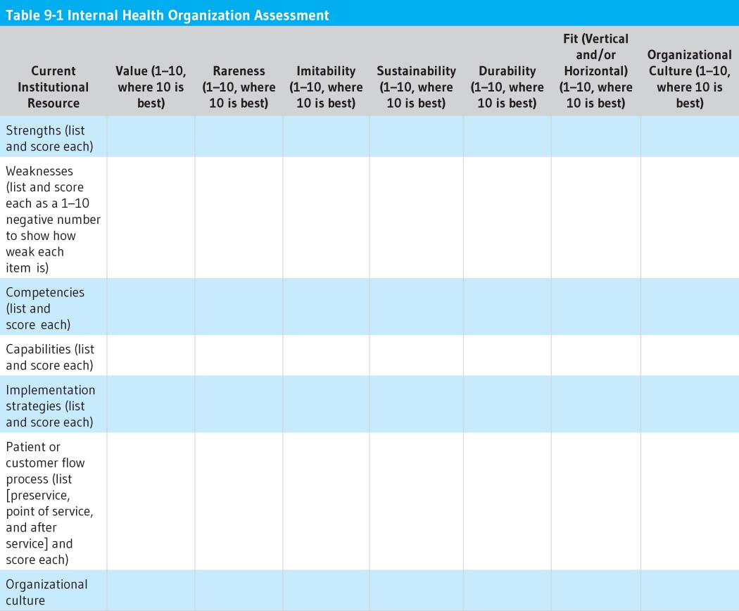

Slide 26
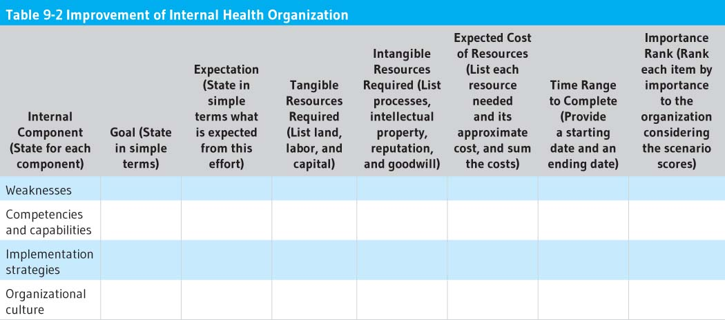

Slide 27
Understanding the External Environment
Understanding the external environment focuses on scanning, monitoring, forecasting, and assessing the macro and micro forces of the external environment.
Scanning involves identifying the subtle to dramatic signals of macro and micro forces change.
Monitoring focuses on deriving meaning from a pattern of observations from scanning macro and micro forces.

Slide 28
Understanding External Environment, cont.
Forecasting is the active development of projections and likely scenarios based on patterns indicated from monitoring.
Assessing is prioritizing and quantifying the impact of changes in the macro and micro forces’ external environment, considering scenario forecasts in that valuation.
Categories to give leaders structure through which to scan, monitor, forecast, and assess a dynamic health industry:
Macro-environmental forces
Health care environmental [micro-environmental] forces
SWOT analysis

Slide 29
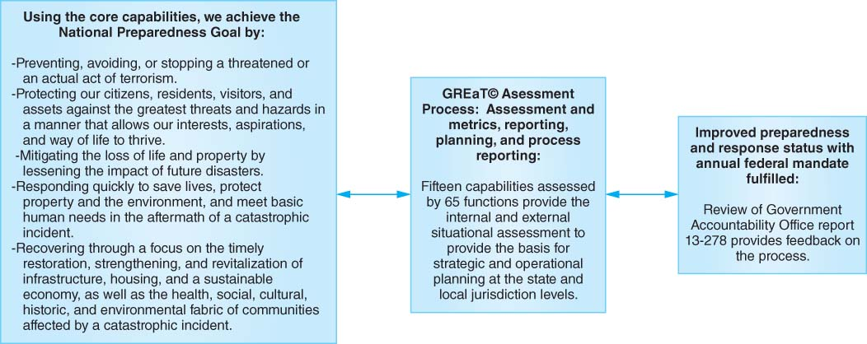
Figure 9-2

Slide 30
Program Guidelines
PHEP program guidelines provide the basis for assessment of capabilities and functions for public health preparedness.
HPP program guidelines provide the basis for assessment of capabilities and functions for healthcare delivery organizations/hospitals. Both of these programs are funded and managed separately but now require alignment and integration to provide a better “picture” of preparedness.

Slide 31
Horizontal Factors
Horizontal organizations are organizations that have cooperative relationships, affiliations, or ownership rights with multiple outside agents and actors.
Horizontal organizations seek to maintain a level of homeostasis with all elements internal and external to the establishment.

Slide 32
Vertical Factors
The horizontal organization is in stark contrast to the vertical organization.
The vertical organization builds a monument unto itself and seeks to minimize reliance on any and all outside stakeholders and actors.
In the true sense of organizational dynamics there are actually few true vertical organizations. As a result, when we speak of vertical organizations, we refer to organizations that attempt to control the environment first rather than living in the environment and becoming a participatory member within the community.

Slide 33
Dynamic Factors
Dynamic organizations are those that do not qualify as either vertical or horizontal organizations. However, there is a tendency for many dynamic organizations to fit into the open and horizontal architecture.
Different possibilities in the environmental characteristics constantly require the creation of new and different ways of positioning the organization for success.

Slide 34
Organizational Culture
From a broad perspective, health leaders assess the external and internal environments of the organization, determine what organizational culture will best meet the needs of the external environment, then design, develop, implement, and refine the organizational culture.
From this “big picture” view, leadership seems simple, yet accomplishing the task of organizational alignment with the external environment requires a focused, clear appealing vision that is well communicated and leadership and management team actions consistent with that vision.

Slide 35
Organizational Culture, cont.
From this standpoint, leaders must be knowledgeable and competent about organizational dynamics, culture, communication, assessment and analysis, and change management.
All of these areas are important, yet culture is the fabric that weaves all of these components together.

Slide 36
Organizational Culture, cont.
To begin moving an organizational culture toward change, the health leader should:
Model the behavior you expect yourself.
Communicate expectations and train other leaders, managers and staff.
Revise structures and reporting relationships.
Conduct team-based planning and policy development.
Use primary and secondary mechanisms (discussed later in this chapter).

Slide 37
Organizational Culture, cont.
To begin moving an organizational culture toward change, the health leader should (cont.):
Be consistent and communicate often to the organization.
Continue to scan, monitor, and assess the internal health organization environment while you scan, monitor, forecast, and assess the external environment.

Slide 38
Organizational Culture, cont.
Defining organizational culture
Organizational culture is a complex construct that incorporates many concepts and multitudes of variables.
It consists of a large set of largely ignored or invisible assumptions that deal with how group members interpret both their external relationships (external environment) and their internal relationships with each other. Culture is an outcome of group learning.
As people solve problems together successfully, a condition for culture formation exists.

Slide 39
Organizational Culture, cont.
Defining organizational culture (cont.)
Edgar Schein defines culture as a pattern of basic assumptions that are invented, discovered, or developed by a given group as it learns to cope with its problems of external adaptation and integration.
These assumptions have worked well enough to be considered valid and, therefore, have to be taught to new members as the correct way to perceive, think, and feel in relation to their problems, challenges, and opportunities.

Slide 40
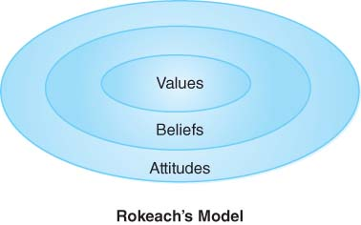
Figure 9-3
Data from Beebe, S. A., & Masterson, J. T. (1997). Communicating in small groups: Principles and practices (5th ed.). New York: Addison-Wesley Educational, p. 174.

Slide 41
Organizational Culture Levels
Level 1: Artifacts and creations
These elements are most visible and include the organization’s constructed social and physical environment.
This level includes technology, art, visible and audible behavior patterns (visible but often not decipherable) such as written and spoken language, overt behaviors, and how members demonstrate status.

Slide 42
Organizational Culture Levels, cont.
Level 2: Values
These are testable in the physical environment; they are testable only by social consensus (such as taking care of patients).
Central values provide the day-to-day operating principles by which the members of the culture guide their behavior.
As values are taken for granted, they gradually become beliefs and drop out of consciousness, just as habits become unconscious and automatic.

Slide 43
Organizational Culture Levels, cont.
Level 3: Basic underlying assumptions
These include relationship to the environment; nature of reality, time, and space; nature of human nature; nature of human activity; and nature of human relationships (taken for granted, invisible, preconscious); implicit assumptions tell group members how to perceive, think about, and feel about things.
These assumptions are taken for granted; members would find behavior based on any other premise inconceivable.

Slide 44
Interpersonal Interaction Model
This typology categorizes organizational cultures into one of four types:
Power culture: Strong leaders are needed to distribute resources. Leaders are firm, but fair and generous to loyal followers. If the organization is badly led, there is rule by fear, abuse of power for personal gain, and political intrigue.

Slide 45
Interpersonal Interaction Model, cont.
Four organizational culture types (cont.):
Achievement culture: Results are rewarded, not unproductive efforts. Work teams are self-directed. Rules and structure serve the system, but not as an end by themselves. A possible downside is sustaining energy and enthusiasm over time.
Support culture: Employees are valued as people, as well as a workers. Employee harmony is important. The weakness is a possible internal commitment without an external task focus.

Slide 46
Interpersonal Interaction Model, cont.
Four organizational culture types (cont.):
Role culture: There is rule of law that outlines clear responsibilities; reward systems are tight, with tight coupling to responsibilities. This type provides stability, justice, and efficiency. Its weakness is in impersonal operating procedures and a stifling of creativity and innovation.

Slide 47
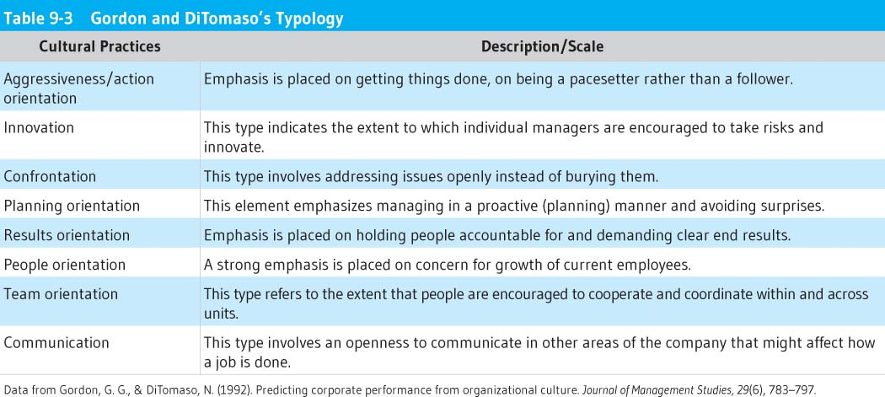
Data from Gordon, G. G., & DiTomaso, N. (1992). Predicting corporate performance from organizational culture. Journal of Management Studies, 29(6), 783–797.

Slide 48
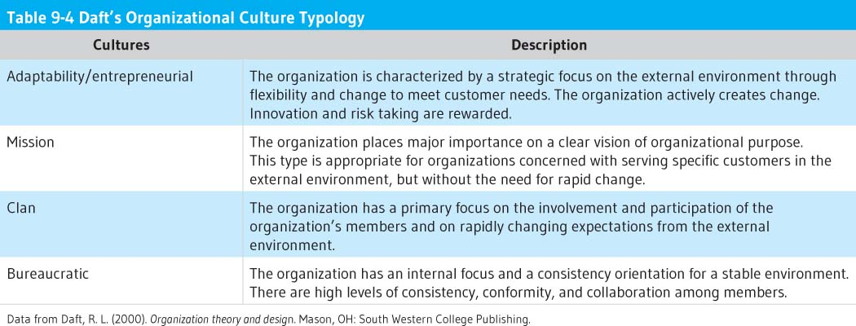
Data from Daft, R. L. (2000). Organization theory and design. Mason, OH: South Western College Publishing.

Slide 49
Societal Expression Cultures
There are different types of culture, just like there are different types of personality. Sonnenfeld identified the following four types of cultures:
Academy culture: Employees are highly skilled and tend to stay in the organization, while working their way up the ranks. The organization provides a stable environment for employees to develop and exercise their skills. Examples are universities, hospitals, large corporations, etc.

Slide 50
Societal Expression Cultures, cont.
Four types of culture (cont.):
Baseball team culture: Employees are "free agents" who have highly prized skills. They are in high demand and can rather easily get jobs elsewhere. This type of culture exists in fast-paced, high-risk organizations, such as investment banking, advertising, etc.

Slide 51
Societal Expression Cultures, cont.
Four types of culture (cont.):
Club culture: The most important requirement for employees in this culture is to fit into the group. Usually employees start at the bottom and stay with the organization. The organization promotes from within and highly values seniority. Examples are the military, some law firms, etc.

Slide 52
Societal Expression Cultures, cont.
Four types of culture (cont.):
Fortress culture: Employees don't know if they'll be laid off or not. These organizations often undergo massive reorganization. There are many opportunities for those with timely, specialized skills. Examples are savings and loans, large car companies, etc.
Office of Minority Health, United States Department of Health and Human Services. (2013). What is cultural competence? Retrieved from http://minorityhealth.hhs.gov/templates/browse.aspx?lvl=2&lvlID=11.

Slide 53
Defining Leadership from an Organizational Culture Context
The unique and important function of leadership, as contrasted with management or administration, is viewed as the conceptualization, creation, and management of organizational culture. Culture is a learned and evolved system of knowledge, behavior, attitudes, beliefs, values, and norms that is shared by a group of people.

Slide 54
Defining Leadership from an Organizational Culture Context, cont.
“Leaders go beyond a narrow focus on power and control in periods of organizational change. They create commitment and energy among stakeholders to make the change work. They create a sense of direction, then nurture and support others who can make the new organization a success.”
Bennis, W., Parikh, J., & Lessem, R. (1996). Beyond Leadership: Balancing Economics, Ethics, and Ecology (rev. ed.). Cambridge, MA: Blackwell.
Health leaders led people and manage resources within a framework of organizational culture.

Slide 55
Changing and Adapting Organizational Culture
Primary embedding mechanisms
Health leaders have a set of powerful tools, behaviors, and mechanisms to develop, refine, maintain, or change organizational culture. These are:
What leaders pay attention to, measure, and control
Leader reactions to critical incidents and organizational crises
Deliberate role modeling, teaching, and coaching by leaders
Criteria for allocation of rewards and status
Criteria for recruitment, selection, promotion, retirement, and excommunication

Slide 56
Changing and Adapting Organizational Culture, cont.
Secondary reinforcement reinforcement mechanisms reinforce the primary embedding mechanisms. The following are of the most importance:
The organization’s design and structure
Organizational systems and procedures
Design of physical space, facades, and buildings
Stories, legends, myths, and parables about important events and people
Formal statements of organizational philosophy, creeds, and charters
Schein calls these “secondary” because they work only if they are consistent with the primary mechanisms.

Slide 57
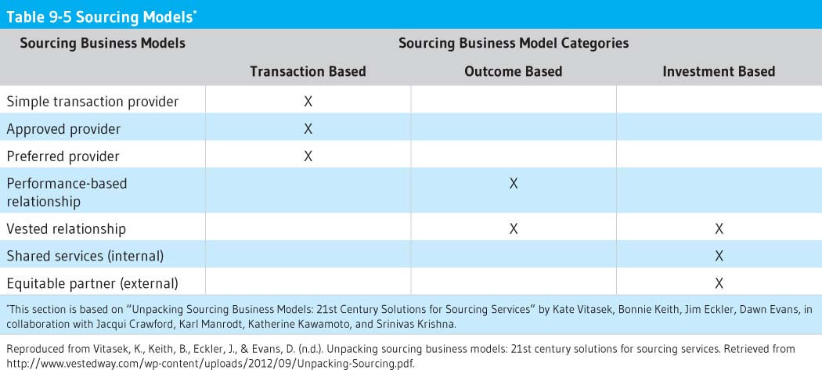
Reproduced from Vitasek, K., Keith, B., Eckler, J., and Evans, D. (n.d.). Unpacking sourcing business models: 21st century solutions for sourcing services. Retrieved
from http://www.vestedway.com/wp-content/uploads/2012/09/Unpacking-Sourcing.pdf.

Slide 58
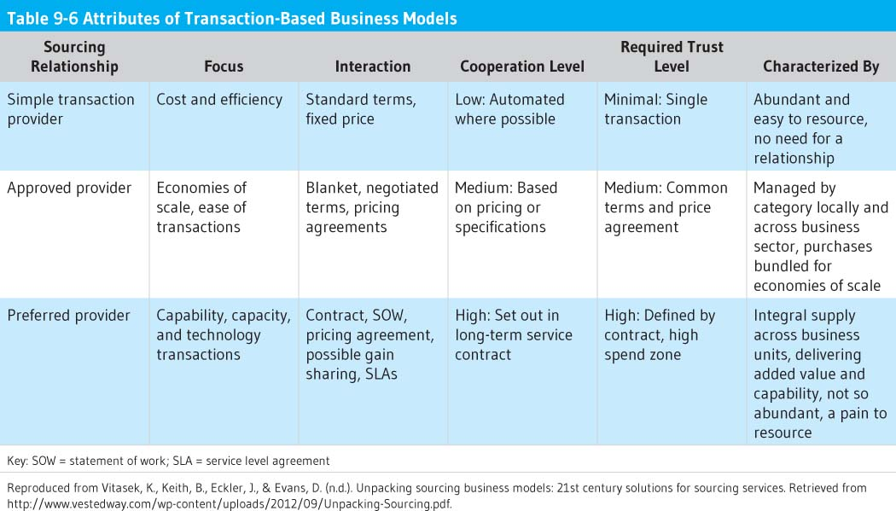

Slide 59
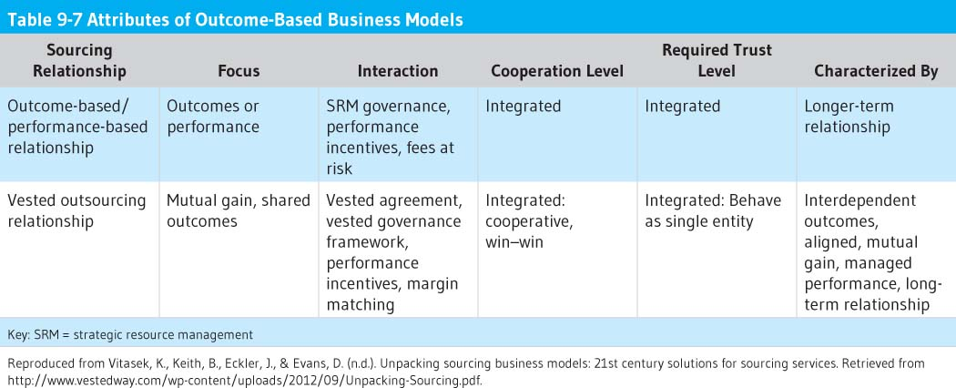
Reproduced from Vitasek, K., Keith, B., Eckler, J., and Evans, D. (n.d.). Unpacking sourcing business models: 21st century solutions for sourcing services. Retrieved
from http://www.vestedway.com/wp-content/uploads/2012/09/Unpacking-Sourcing.pdf.

Slide 60
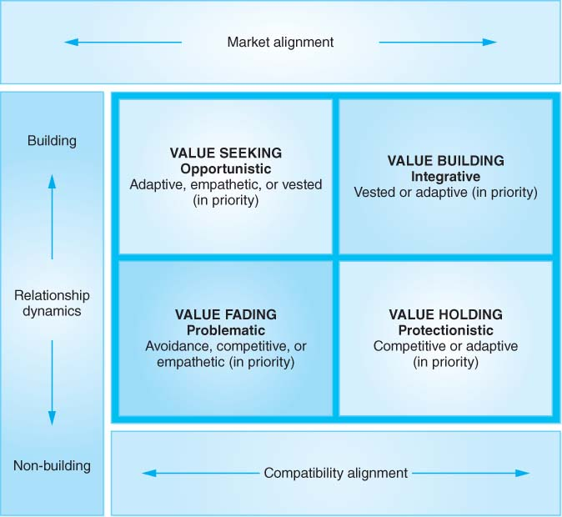
Figure 9-6
Reproduced from Ledlow, G., Manrodt, K., and Stephens, J. (2012) Measuring compatibility gaps in strategic relationships. In N. Delener, et al. (Eds.), Mapping the global future: Evolution through innovation and excellence (pp. 420–431). New York: Global Business and Technology Association.

Slide 61
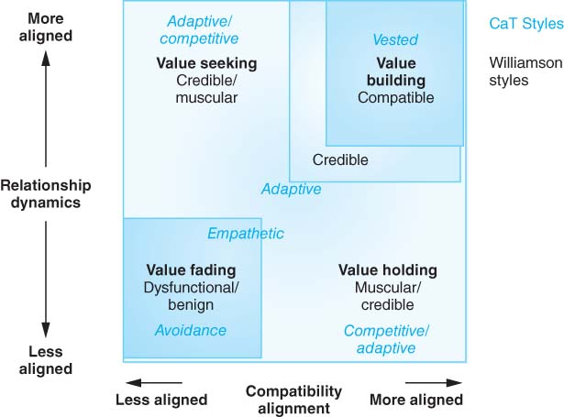
Figure 9-8
© 2011 Jerry Ledlow, PhD, and Karl Manrodt, PhD. Used with permission.

Slide 63
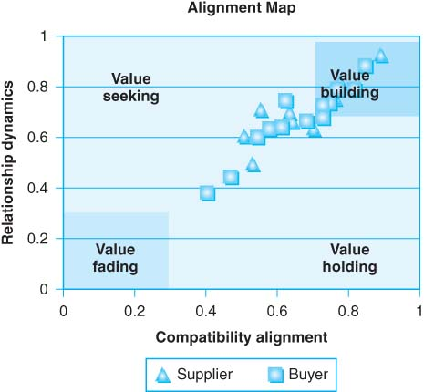
Figure 9-9
Reproduced from Ledlow, G., Manrodt, K., and Stephens, J. (2012). Measuring Compatibility Gaps in Strategic Relationships. In N. Delener, et al. (Eds.), Mapping the global future: Evolution through innovation and excellence (pp. 420–431). New York: Global Business and Technology Association.

Slide 64
Discussion Questions
What are the strategic direction elements of the strategic plan? What are the other elements of the strategic and operational plan, and what are the different challenges a health leader faces in institutional, resource-dependent, and contingent environments? What strategies might you suggest the leader could implement for successful outcomes?
Discuss the levels of organizational culture and summarize the actions and behaviors a health leader would perform to proactively and positively change organizational culture.

Slide 65
Discussion Questions, cont.
Can you predict how strategic planning can positively influence organizational culture and the internal environment? How does strategy selection (competitive, adaptive, etc.) reinforce those changes to organizational culture and the internal environment?

Slide 66
Discussion Questions, cont.
Can you analyze how external and internal environmental factors influence the strategic plan and the organizational culture of a health organization? Highlight the basic differences between vertical and horizontal external environments compared to internal institutional, resource-dependent, and contingent environments. What are the strategies a health leader operating in these environments might be able to leverage to ensure success?

Slide 67
Discussion Questions, cont.
Discuss a methodology to perform internal environmental scanning, monitoring, and assessment and external environmental scanning, forecasting, and monitoring for a hospital, group practice, public health organization, long-term care organization, or stand-alone allied health practice or retail pharmacy.

Slide 68
Discussion Questions, cont.
Explain how you would interpret the current external environmental factors in the health industry; translate your interpretation into a critical list for action for a health organization. How could you appraise each element on the critical list for action as to where it should be addressed by the health organization (strategic plan, directional strategies, external/internal environment, organizational culture, etc.) noting that critical list items may impact more than one area of the health organization?

Slide 69
Exercises
Identify the different challenges a health leader faces in institutional, resource-dependent and contingent environments? What strategies should a health leader implement for successful outcomes? Write this answer in one to two pages.
Summarize the levels of organizational culture and estimate the actions and behaviors a health leader would perform to proactively and positively change organizational culture in one to one and a half pages.

Slide 70
Exercises, cont.
Explain how strategic planning can positively influence organizational culture and the internal environment. Describe how strategy selection (competitive, adaptive, etc.) reinforces those changes to organizational culture and the internal environment in one to two pages.

Slide 71
Exercises, cont.
Analyze how external and internal environmental factors influence the strategic plan and the organizational culture of a health organization, highlighting the basic differences between vertical and horizontal external environments compared with internal institutional, resource-dependent, and contingent environments? What are the strategies a health leader operating in these environments might be able to leverage to ensure success? Provide your answer in two to three pages.

Slide 72
Exercises, cont.
Design a methodology to perform internal environmental scanning, monitoring, and assessment and external environmental scanning, forecasting, and monitoring for a hospital, group practice, public health organization, long-term care organization, or stand-alone allied health practice or retail pharmacy in one to two pages.

Slide 73
Exercises, cont.
Evaluate and interpret the current external environmental factors in the health industry; translate your interpretation into a critical list for action for a health organization. How could you appraise each element on the critical list for action as to where it should be addressed by the health organization (strategic plan, directional strategies, external/internal environment, organizational culture, etc.) noting that critical list items may impact more than one area of the health organization?

