Slide 2
Employee and Labor Relations
Chapter 10

Slide 3
Labor Relations
Functions of trust and communication
Trust is faith in character and actions of another.
To improve others’ level of trust, all need to be open and honest.
Communication is transmitting information and meaning, verbally, nonverbally, or in writing.
Notes:
Labor Relations: A Function of Trust and Communication
Trust is faith in the character and actions of another.
To improve others’ level of trust in us, we need to be open and honest.
Communication is the process of transmitting information and meaning, verbally, nonverbally or in writing.

Slide 4
The Message-Sending Process
Develop rapport
State your communication objective
Transmit your message
Check the receiver’s understanding
Get a commitment and follow up
Notes:
Feedback is information provided by the receiver that verifies that a message was transmitted successfully.
Paraphrasing is the process of restating a message back to the original sender in the receiver’s own words.

Slide 5
Checking Understanding
Feedback
Information provided by receiver that verifies a message was transmitted successfully.
Paraphrasing
Restating a message back to original sender in receiver’s own words.

Slide 6
The Message-Receiving Process
Notes:
Feedback is information provided by the receiver that verifies that a message was transmitted successfully.
Paraphrasing is the process of restating a message back to the original sender in the receiver’s own words.

Slide 7
Job Satisfaction
Feelings of well-being and acceptance of place in organization.
Generally measured along a continuum from:
Satisfied/positive/high
Dissatisfied/negative/low
Affects worker productivity, absenteeism, and turnover.

Slide 8
Job Dissatisfaction
Causes of poor organizational outcomes, including:
Losing good employees and costly turnover
Lower levels of health, wellness, and productivity
Higher levels of alcohol and/or other substance abuse
Physical or psychological withdrawal
Theft and sabotage

Slide 9
Measuring Job Satisfaction
Difficult to measure accurately because it is an attitude.
Firms must rely on employees’ honesty in self-reporting their level of satisfaction on job satisfaction (attitude) surveys.
Since honesty requires trust, employers must ensure employees’ anonymity is protected.

Slide 10
Ways to Measure Job Satisfaction
Faces scale
Employees circle the face that matches their satisfaction.
Best for a brief job satisfaction assessment.
Job satisfaction survey (JSS)
Organizational development survey that is valid and reliable for measuring job satisfaction in workplace. Uses NINE Factors.
Best for an in-depth job satisfaction assessment.
Notes:
Job satisfaction is difficult to measure accurately because it is an attitude, so firms must rely on employees’ honesty in self-reporting their level of satisfaction on a job satisfaction (attitude) survey.
Since honesty requires trust, ensure that employees’ anonymity will be protected.
Faces scale
Employees circle the face that most closely matches their satisfaction with their job.
Best for a quick job satisfaction assessment.
Job satisfaction survey (JSS)
An organizational development survey that has been shown to be valid and reliable for measuring job satisfaction in the workplace. Uses NINE Factors.
Best for an in-depth job satisfaction assessment.

Slide 11
Legal Issues in Labor Relations
Managers must understand constraints set by labor laws to successfully do their job.
Three types of labor relations laws:
Laws that deal with unions and unionization
Laws that govern how layoffs must be handled
Laws that govern Collective Bargaining

Slide 12
Railway Labor Act (RLA) of 1926
Enacted to limit potential for railroad strikes to affect interstate commerce.
Provides protection for worker rights to join a union. No more Yellow Dog contracts.
Requires that in major disputes, management and labor must participate in a negotiation and mediation process presided by the National Mediation Board before a strike may be called.

Slide 13
National Labor Relations Act (NLRA) of 1935 (The Wagner Act)
Gives employees rights, without fear of persecution, to:
Self-organize or form, join, or assist labor organizations
Bargain collectively through representatives of their choosing
Engage in concerted activities to collective bargain or other mutual aid or protection
Refrain from such activities unless that right may be affected by an agreement that requires membership in a labor organization as a condition of employment

Slide 14
Labor Management Relations Act (LMRA) of 1947 (Taft-Hartley Act)
Amendment to 1935 NLRA that rebalanced employer and employee rights by prohibiting specific unfair practices by unions, including:
Jurisdictional and wildcat strikes
Thirdary boycotts
Union shops
Coercive tactics

Slide 15
Labor Management Reporting and Disclosure Act (LMRDA) of 1959 (The Landrum-Griffin Act)
Requires a series of disclosures by union officials and provides specific rights to union members.
Enacted because of organized crime/national labor union linkages in the 1950s.

Slide 16
Worker Adjustment and Retraining Notification Act (WARN) of 1988
Firms that employ more than 100 full-time employees must notify them of a layoff at least 60 days ahead of time when laying off more than 50 employees.
All workers are entitled to this notice, including hourly and salaried workers and managers.

Slide 17
Corporate Whistleblowers and the Law
Whistleblowers are employees who tell an organization with authority, outside their own company, about actions within their company that they believe to be illegal.
Whistleblower laws
Federal False Claims Act
Dodd-Frank Act

Slide 18
Express Contracts, Implied Contracts, and Quasi-Contracts
Express contract
When agreement between two parties is specifically stated, orally or written.
Implied contract
When an agreement is formed by parties’ actions rather than as results of a specific oral or written agreement.
Quasi contract
A court ordered implied agreement that prevents one party from benefiting at the expense of another.

Slide 19
Other Legal Issues in Labor Relations
Wrongful discharge
Terminating employee for an illegal reason due to violation of a contract or violation of a state or federal law.
Constructive discharge
Occurs when employee is forced to quit because of severe and/or pervasive harassment or intolerable working conditions.
Notes:
Wrongful discharge--terminating an individual employee for an illegal reason, either due to a violation of a contract or in violation of a state or federal law.
Constructive discharge--occurs when an employee is forced to quit because of severe and/or pervasive harassment or intolerable working conditions.

Slide 20
Union Organizing
People join unions for a variety of reasons, including:
Better pay and benefits
Unfair management practices
Poor labor relations
Job security
Notes:
People join unions for a variety of reasons, including better pay and benefits (especially good health care coverage and retirement plans); unfair management practices that lead to poor labor relations; and job security.

Slide 21
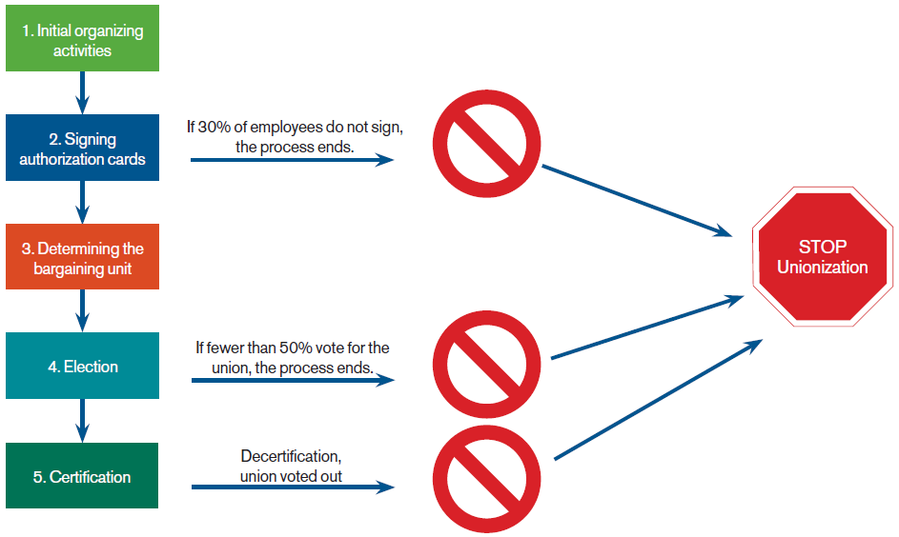
The Union Organizing Process
Notes:
Union organizing--The NO TIPS Rule.
No threats--Managers can’t threaten that the firm will shut down a facility that votes for unionization.
No interrogations--Managers can’t ask an employee about union organizing activities.
No promises--Managers can’t promise employees pay or benefits rewards if they vote against union authorization.
No spying--Managers can’t plant spies in union organizing meetings or other activities.

Slide 22
Union Organizing: The NO TIPS Rule
No Threats--Managers cannot threaten firm will shut down a facility that votes for unionization.
No Interrogations--Managers cannot ask employees about union organizing activities.
No Promises--Managers cannot promise employees pay or benefits rewards if they vote against union authorization.
No Spying--Managers cannot plant spies in union organizing meetings or other activities.
Notes:
Union organizing--The NO TIPS Rule.
No threats--Managers can’t threaten that the firm will shut down a facility that votes for unionization.
No interrogations--Managers can’t ask an employee about union organizing activities.
No promises--Managers can’t promise employees pay or benefits rewards if they vote against union authorization.
No spying--Managers can’t plant spies in union organizing meetings or other activities.

Slide 23
Labor Relations and Collective Bargaining
Labor relations
Interactions between management and unionized employees.
Collective bargaining
Negotiation process resulting in a contract between union employees and management that covers employment conditions.
Grievance
Formal complaint concerning pay, working conditions, or violations of other factors in a collective bargaining agreement.
Notes:
Labor relations are the interactions between management and unionized employees.
Collective bargaining is the negotiation process resulting in a contract between union employees and management that covers employment conditions.
A grievance is a formal complaint concerning pay, working conditions, or a violation of some other factor in a collective bargaining agreement.

Slide 24
The Employee Complaint Resolution Model
Listen to the complaint and paraphrase it.
Have the complainer recommend a solution.
Schedule time to get all the facts and/or make a decision
Develop a plan to resolve the complaint.
Implement the plan and follow up.

Slide 25
Management Rights: Limiting Union Organizing Efforts
No unionization on company time--Policy must be consistent with other solicitation policies and company handbook.
Management’s position on unionization--Can state how unionization will affect management/labor relationships, firm, and employees’ pay, and son on.
Change agreements and use of non-union employee representation--management can offer a “non-union employee representation” alternative to union.

Slide 26
Management Rights: Lockouts and Replacement Workers
Lockouts
Management stops work and physically prevents workers from entering workplace.
Management may hire replacement workers, who may replace striking workers permanently or temporarily, in cases of economic strike.

Slide 27
Management Rights: Decertification Elections
Can be held to remove a union, but:
Not within a year of a previous attempt at decertification.
Company cannot initiate a decertification petition or encourage a decertification petition.
If requested by employees, management can provide information to employees regarding decertification, but cannot threaten employees or promise benefits.
Notes:
Decertification elections can be held to remove a union as the representative of company workers. This cannot happen within a year of a previous failed attempt at decertification, and management of the company can’t bring a decertification petition up on its own. Management cannot even directly encourage this action on the part of the employees, but it can provide information to employees regarding decertification processes if they request it, “as long as the company does so without threatening its employees or promising them benefits.”
http://www.shrm.org/TemplatesTools/hrqa/Pages/decertifyaunion.aspx (retrieved July 12, 2017)

Slide 28
Managing Conflict
Conflicts exist when people are in disagreement and opposition. They occur because individuals:
Don’t let others know their expectations and don’t ask others.
Assume others hold same expectations.
Don’t know expectations until people do things in opposition to them.
Important to share information and communicate expectations.

Slide 29
Functional Versus Dysfunctional Conflict
Functional conflict
Helps firm meet its goals of increased performance.
Dysfunctional conflict
Prevents firm from achieving individual and organizational objectives.
Conflict management skills can resolve conflicts and maintain relationships before conflicts become dysfunctional.
Notes:
A conflict exists whenever people are in disagreement and opposition. Conflict is part of every relationship and every social system. You are in conflict when you get aggravated at someone, or when someone does something that bothers you. So, you want to manage it effectively because, if you don’t, you can hurt feelings, kill important relationships, and damage your career. Thus, conflict management is an important skill in your personal and professional lives.

Slide 30
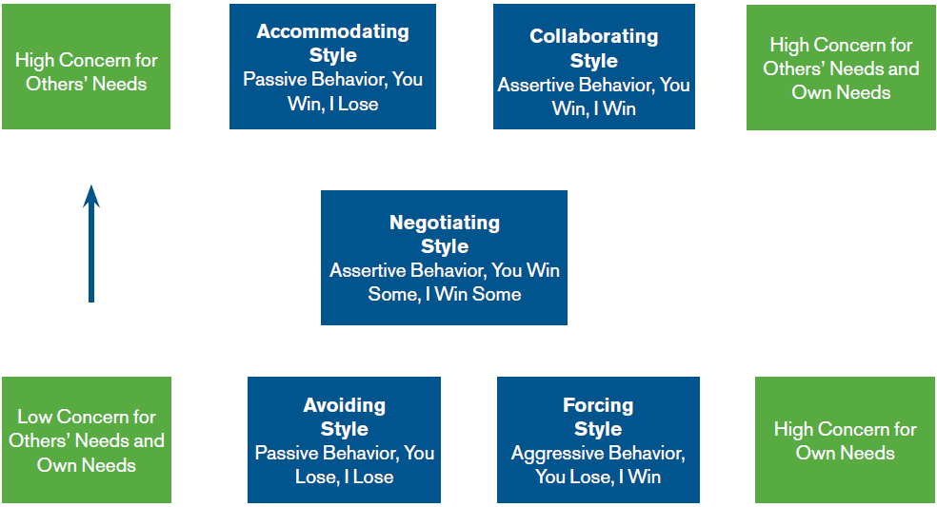
Conflict Management Styles
Notes:
When we are faced with conflict, we have five basic conflict management styles to choose from. The five styles are based on two dimensions of concern: concern for others’ needs and concern for our own needs, and being cooperative or not. Various levels of concern and cooperation result in three types of behavior: passive (taking no action or permissively giving in to others), assertive (defending our position while considering others’ needs), and aggressive (fighting for what we want without considering others’ needs, or taking advantage of others).

Slide 31
Initiating Conflict Resolution
State the problem in terms of behavior, consequences, and feelings (i.e., make a BCF statement).
Allow another person to respond to your BCF statement and acknowledge the problem or conflict.
Ask for and/or present alternative resolutions to the conflict.
Come to an agreement. Determine specific actions to be taken by each person.

Slide 32
Negotiations
Process in which two or more parties in conflict attempt to come to an agreement.
Ideally, negotiation should be viewed by all parties as “I win some and you win some,” rather than a win-lose situation.
Notes:
Negotiating is a process in which two or more parties in conflict attempt to come to an agreement. If there is a set “take it or leave it” deal, there is no negotiation, so good managers generally want to try to avoid making such statements. Also, not all negotiations end with an agreement.
Colvin, G. (2015, December 1). Where disrupters meet aristocrats. Fortune, p. 28.

Slide 33
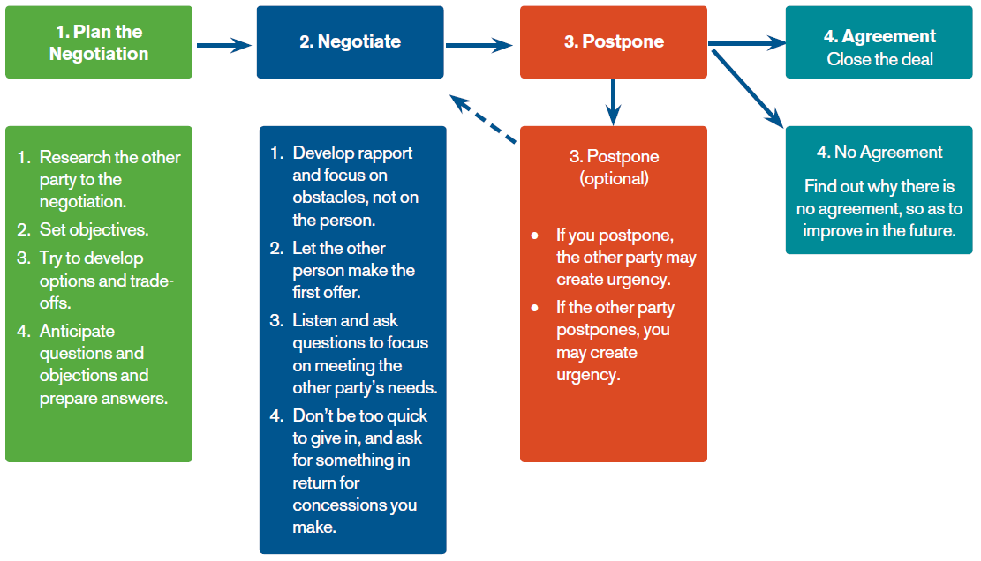
The Negotiation Process
Notes:
Not everyone is born a great negotiator, but the skill can be developed. Following the steps in the negotiation process can help you develop your negotiation skills. The negotiation process has three and possibly four parts. These steps are summarized in Model 10-5 and discussed throughout this section. We discuss the process in two parts to reflect the planning and actual negotiation in which you may or may not postpone or agree to make a deal. In the course of actual negotiations, you may have to make slight adjustments to the steps in the process. Charlier, S. D. (2014). Incorporating evidence-based management into management curricula: A conversation with Gary Latham. Academy of Management Learning & Education, 13, 467–475.

Slide 34
Alternative Dispute Resolution (ADR)--Mediation and Arbitration
When labor and management cannot resolve conflicts, ADR may be used.
Mediator
Neutral third party who helps resolve a conflict, but has no authority to impose a solution to the conflict.
Arbitrator
Neutral third party who resolves a conflict by making a binding decision.
Notes:
Labor and management are required by law to bargain with each other in good faith, and companies need to maintain effective employee relations--but when in conflict, we cannot always resolve our dispute alone. In these cases, we can use something called alternative dispute resolution. Alternative dispute resolution includes a series of tools, most commonly either mediation or arbitration, which parties in conflict can use to resolve their disagreements without going through the process of litigation

