Slide 1
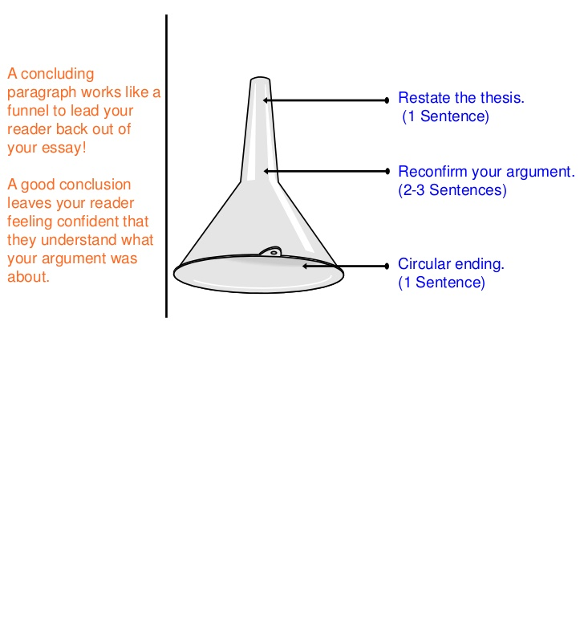
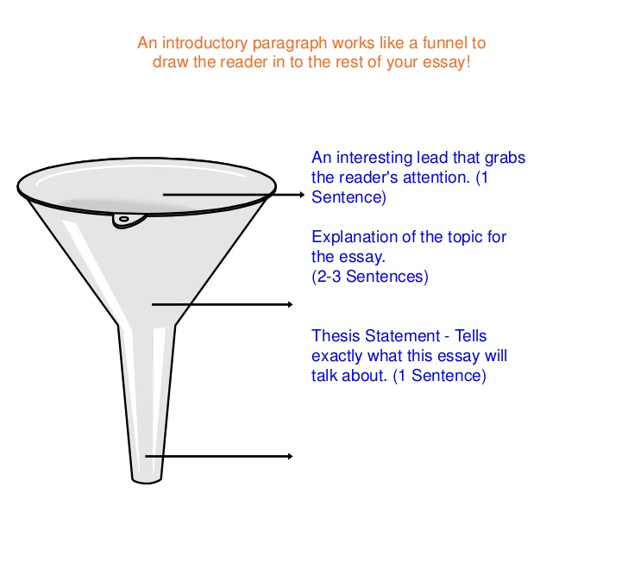
Introduction and Conclusion- the funnel approach
Introduction
Conclusion

Slide 2
Writing and Structure
Avoid use of emotive language e.g. staggering rates, drastic measures, combat, alarmingly high etc. Academic writing should be free of emotion.
Use of capital letters, particularly with proper nouns e.g.
World Health Organization NOT world health organisation, World health organisation, World Health organisation
Health promotion
If at start of sentence then use Health promotion NOT Health Promotion
Middle of sentence use health promotion NOT Health Promotion, Health promotion
La Trobe NOT Latrobe

Slide 3
Writing and Structure
Use of direct quotes
Direct quotes should be used sparingly i.e. 1-2 quotes is more than sufficient in as assessment of this size
Paraphrasing makes for better academic writing
Paraphrasing is about taking an idea and putting it in your own words; not taking a slab of text and changing a few words
Quotes are not included in word counts, so if you are using a lot of quotes, then you run the risk of not meeting the word limit and will be penalised, and getting the comment “this is not your work” or being referred to the Academic Integrity Advisers for potential academic misconduct
Short quotes should be integrated into the flow of sentences, and not left hanging i.e. they should not be a sentence on their own, they need context.

Slide 4
Referencing
Refer to APA guide for correct style for both in-text citations and reference list
Reference list should only include sources cited in-text
Reference list must be presented in alphabetical order
Do not change the ordering of authors (authors are listed in a particular order for a reason, and a lot of consideration has gone into this ordering by the authors)

