Slide 1
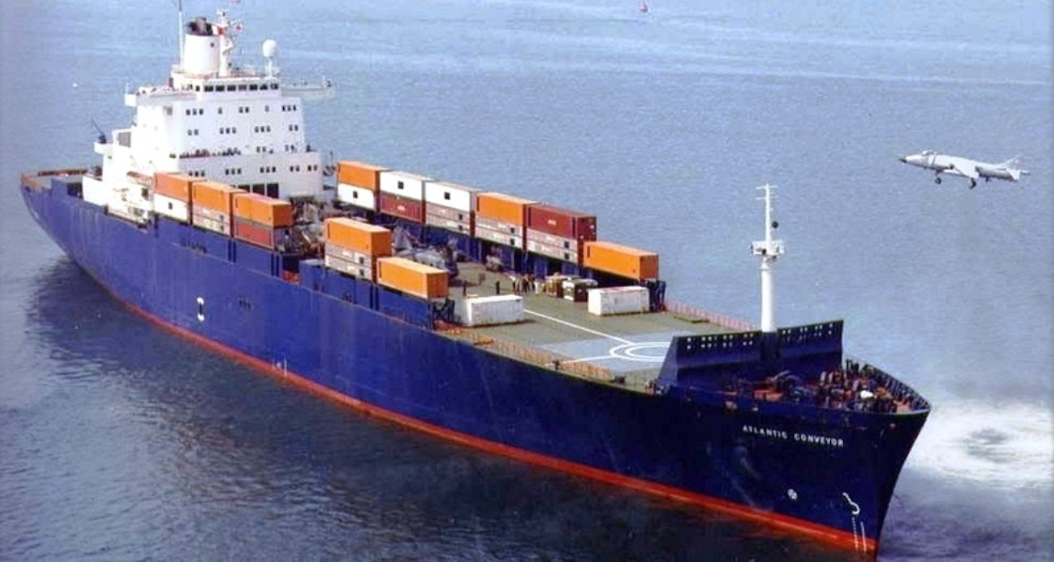
STC 355 Shipping economics and trade.

Slide 2
1.12 Five Demand Factors.

Slide 3
Describe the five main factors affecting Demand.

Slide 4
Key Influences demand.
As far as demand for sea transport is concerned the five main variables are:
The world economy.
Seaborne commodity trades.
Average haul.
Random shocks.
Transport costs.

Slide 5
1.The World Economy.
As we saw in shipping cycles the world economy is the most important factor affecting demand. That there should be a close relationship is only to be expected, since the world economy generates most of the demand for sea transport, through either the import of raw materials for manufacturing industry or the trade in manufactured products.
Therefore judging trends in the shipping market requires knowledge of the present developments in the world economy. This relationship between sea trade and world industry is not, however, simple or direct.
There are two different aspects of the world economy that may bring about change in the demand for sea transport: the business cycle and the trade development cycle.
The business cycle lays the foundation for freight cycles. Fluctuations in the rate of economic growth work through into seaborne trade, creating a cyclical pattern of demand for ships.
The regional trade development cycle (nations going through a period of transition from a traditional society to a society of mass consumption and, hence, develop different consumption/production patterns of raw materials or merchandise) have a major impact on the demand for seaborne commodity transport. Example: China 2000 onwards.
Notes:
Page 138 stopford

Slide 6
2. Seaborne Commodity Trades.
Seaborne commodity trades, which may be subject to seasonal cycles in the short run (examples can be found in the crude oil, grain, or container trade) and which may evolve in the long run, resulting from:
a)changing industrial demands – crude oil demand grew two/three times faster than the economy in the 1960’s because oil was cheap and Western Europe and Japan switched form coal to oil. In the 1970’s oil prices increased and the demand for oil decreased with coal gaining some of its market share.
b)changing transport policies – for example oil, until 1970’s oil companies planned their own tonnage requirements with less than 10% on the spot market. After the oil crisis in 1973 trade became more uncertain, oil companies changed policy and shifted around 50% of their requirements to the spot market.
c)depletion or discovery of resources – again we can look at the oil market, the middle east was the main source of crude oil until the 1970’s where new oil reserves where found in the North sea and Alaska reducing need for deep sea imports.
d)relocation of processing plants –this can affect volume shipped and type of ship used. For example the raw material for aluminium is bauxite, it takes 6 tonnes of bauxite to produce 1 tonne of aluminium. Therefore if it is refined before shipment we can reduce the volume shipped and the size of vessel required.
Notes:
Page 145 more crude oil shipped to northern hemisphere in autumn and run upto winter than in spring summer. Containers more shipped in run up to christmas period.

Slide 7
3. Average Haul and ton miles.
Average haul and ton miles, being the more precise measurement of the demand side than the volume of shipped goods as the distance over which the commodities are transported can vary widely and often demand peaks (resulting in a higher volume) have to be satisfied using more distant suppliers (generating an even larger impact on the ton miles).
The effect on ship demand of changing the average haul has been dramatically
illustrated several times in the past by the closure of the Suez Canal, which
increased the average distance by sea from the Arabian Gulf to Europe from 6,000 miles to 11,000 miles. As a result of the sudden increase in ship demand there was a freight market boom on each occasion.
Notes:
Page 146 stopford

Slide 8
4. Random Shocks.
Random shocks which upset the stability of the economic system may contribute to the cyclical process. Weather changes, wars, new resources, commodity price changes, are all candidates. These differ from cycles because they are unique, often precipitated by some particular event, and their impact on the shipping market is often very severe.
The most important influence on the shipping market are economic shocks. These are specific economic disturbances which are superimposed on business cycles, often with dramatic effects.
The US financial crisis of the early 1990s and the stock market crash in 2000 are examples of this. The singular feature of these economic shocks is that their timing is unpredictable and they bring about a sudden and unexpected change in ship demand.
In addition to economic shocks, from time to time political events such as a localized war, a revolution, the political nationalization of foreign assets or strikes can disrupt trade. Events of this type do not necessarily impact directly on ship demand; it is generally their indirect consequences that are significant.
The Korean war 1950’s, Suez crisis 1956, Six day war 1967,1990 Gulf war, 2002 Venezuelan oil strike among others have had an impact on the demand for sea transport.
Notes:
Page 138 stopford further examples great depression 1930’s

Slide 9
5.Transport Costs.
Finally, the cost of sea transport. As the general theory of maritime trade suggests that trade takes place if a commodity can be bought more cheaply in a different country, the ever declining cost of transport (resulting from the economies of scale) in itself has helped to boost maritime trade.
Raw materials will only be transported from distant sources if the cost of the shipping operation can be reduced to an acceptable level or some major benefit is obtained in quality of product. This makes transport costs a significant factor for
industry .
Over the last century, improved efficiency, bigger ships and more effective organization of the shipping operation have brought about a steady reduction in transport costs and higher quality of service.
Although transport costs may not appear to have such a dramatic influence upon seaborne trade as the world economy, their long-term effect on trade development should not be underrated.
Notes:
Page 138 stopford

Slide 10
Describe the five main factors affecting Demand.
Recap:

