Slide 1
Displacement affected communities
Introduction to Global Forced Migration Studies
Week 7, Anna Lindley

Slide 2
Last week we noted:
Multiplicity of strategies and relations involved in securing a means of living, often in highly inauspicious environments
Importance of strategic dispersal - thinking of mobility as a process, not an event
Gaps between law / policy and realities – lack of implementation of policies can work to detriment or in favour of refugees

Slide 3
Today
Exploring impacts of refugee presence in wider communities
Policy initiatives promoting self-reliance and wider development
Case study of Jordan Compact (exercise/discussion)

Slide 4
1. Exploring impacts of refugee presence in wider communities

Slide 5
Measuring macro significance…?
 | Numbers of refugees (m) | Refugees per 1,000 inhabitants | Refugees per $1 GDP per capita
1 | Turkey (1.8) | Lebanon (209) | Ethiopia (469)
2 | Pakistan (1.5) | Jordan (90) | Pakistan (322)
3 | Lebanon (1.2) | Nauru (51) | Uganda (216)
4 | Iran (0.98) | Chad (31) | DR Congo (208)
5 | Ethiopia (0.7) | Turkey (24) | Chad (193)
6 | Jordan (0.66) | S Sudan (22) | Kenya (186)
7 | Kenya (0.55) | Mauritania (19) | S Sudan (135)
8 | Uganda (0.43) | Djibouti (17) | Afghanistan (117)
9 | Chad (0.42) | Sweden (15) | Cameroon (102)
10 | Sudan (0.36) | Malta (15) | Turkey (94)
Notes:
UNCHR Global Trends a few years ago…

Slide 6
Measuring macro significance…?
 | Numbers of refugees (m) | Refugees per 1,000 inhabitants | Refugees per $1 GDP per capita
1 | Turkey (1.8) | Lebanon (209) | Ethiopia (469)
2 | Pakistan (1.5) | Jordan (90) | Pakistan (322)
3 | Lebanon (1.2) | Nauru (51) | Uganda (216)
4 | Iran (0.98) | Chad (31) | DR Congo (208)
5 | Ethiopia (0.7) | Turkey (24) | Chad (193)
6 | Jordan (0.66) | S Sudan (22) | Kenya (186)
7 | Kenya (0.55) | Mauritania (19) | S Sudan (135)
8 | Uganda (0.43) | Djibouti (17) | Afghanistan (117)
9 | Chad (0.42) | Sweden (15) | Cameroon (102)
10 | Sudan (0.36) | Malta (15) | Turkey (94)

Slide 7
Measuring macro significance…?
 | Numbers of refugees (m) | Refugees per 1,000 inhabitants | Refugees per $1 GDP per capita
1 | Turkey (1.8) | Lebanon (209) | Ethiopia (469)
2 | Pakistan (1.5) | Jordan (90) | Pakistan (322)
3 | Lebanon (1.2) | Nauru (51) | Uganda (216)
4 | Iran (0.98) | Chad (31) | DR Congo (208)
5 | Ethiopia (0.7) | Turkey (24) | Chad (193)
6 | Jordan (0.66) | S Sudan (22) | Kenya (186)
7 | Kenya (0.55) | Mauritania (19) | S Sudan (135)
8 | Uganda (0.43) | Djibouti (17) | Afghanistan (117)
9 | Chad (0.42) | Sweden (15) | Cameroon (102)
10 | Sudan (0.36) | Malta (15) | Turkey (94)
Regions of origin bear the brunt of displacement

Slide 8
Impact of refugee presence?
Will be mediated by:
Scale of movement – and timing
Characteristics of refugees – assets, e.g. skills, finance, social capital
Political economy of country where they settle – domestic politics, economic pressures/opportunities
Patterns of settlement – spontaneous and officially-organised
Policy responses – humanitarian assistance, what rights allowed
Impacts play out via the local interactions of refugees…

Slide 9
‘Host communities’?
Refugees may settle scattered or clustered in urban and rural areas, in (sponteneously or officially) organised settlements or camps – ‘host communities’ are the people already living locally who are not refugees.
What counts as ‘living locally’ is up for discussion – e.g. Enghoff et al. 2010 considered 50 km radius of routine interaction between Kenyan Dadaab camps and local communities.
Note overlapping refugee movements typical of protracted displacement: ‘host communities’ may include refugees settled earlier on (Fiddian-Qasmiyeh 2016)
Host communities are not homogenous. Different people have different portfolios of assets, access/influence, structural constraints and livelihood strategies. So may be differently affected by refugees settling and pursuing their own livelihoods in the vicinity.
For example, in 1986 Robert Chambers drew attention to absence of research on the impact of refugee presence on local communities, arguing broadly that better off people tend to gain, whereas poorer hosts are ‘hidden losers’
Impacts of refugee presence on host community have been explored in relation to economic, environmental and social impact – results suggest that impact is highly context-specific, depends on local conditions.
We can explore impact specifically on: e.g. prices, labour & wages, service provision, economic development, social cohesion

Slide 10
Impact on prices
Refugee presence may result in depletion of local food supplies, driving up prices. This benefits surplus farmers, and traders supplying these foods, disadvantages those who may be forced to buy food (subsistence farmers, landless laborer)
But can have opposite effect. If food rations are supplied to refugees, they may be able to barter food locally, increasing local supply, pushing those food prices down. Price of items not available in camps (meat, vegetables) may go up.
May increase direct access to food. Refugees may gift food to poor local people. In some contexts, instances of poor local people in borderlands co-ethnic with refugees may register as refugees to access food assistance.
Refugee presence may lead to greater cross-border trade with some impacts on availability of goods, services – as well as prices of these
Timeframe matters: short-term often prices of basic products go up, longer-term often decreases.
Land, housing (purchase and rental) prices may go up benefiting landlords to detriment of other local people, especially renters.
Note growth in cash transfers to refugees – tendency to focus on alleviation of food insecurity in short term. Development of some initiatives similar to long-term social protection programmes, e.g. UNHCR Jordan.

Slide 11
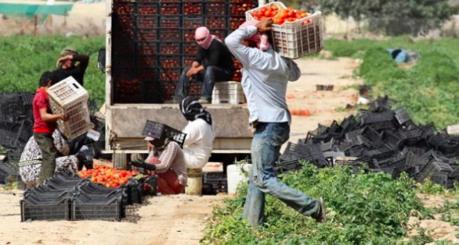
Labour market impact
Refugee labour tends to be cheaper – subsidised by food rations, may have fewer other alternative livelihood strategies, may be prohibited from working, so confined to lower-skill informal jobs and more vulnerable and compliant.
Benefits those able to employ refugees. E.g. where there is an abundance of land and production constrained by lack of labour, refugees have allowed cultivation of larger areas.
Where refugees have substitutable (not complementary) attributes with local workers, competition disadvantage locals, driving wages down and unemployment up
But refugee presence typically increases demand, which can create new jobs in related businesses (some run by locals / employing locals) and in refugee camps with international organaisations/implementing partners/government
Notes:
https://www.al-fanarmedia.org/2017/02/lebanon-jordan-syrians-face-bleak-employment-future/

Slide 12
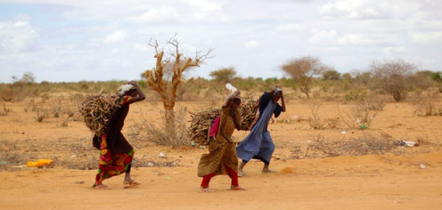
Common property resources
e.g. grazing, wood, water, wild foods, fish/animals... regulated by social norms.
Refugees may occupy on common land; in the absence of adequate livelihood opportunities / shared approach, may deplete these resources, e.g. deforestation to secure firewood.
Poorest depend most on common property – for subsistence and income-generation – so adversely affected by erosion.
Common flashpoint, because has very visible and tangible impact, and affects everyone (cf. labour which divides host community)
Notes:
https://www.newsdeeply.com/refugees/articles/2016/03/22/hunger-a-currency-of-survival-at-dadaab

Slide 13
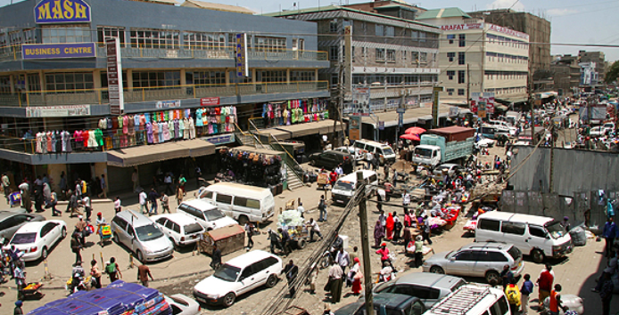
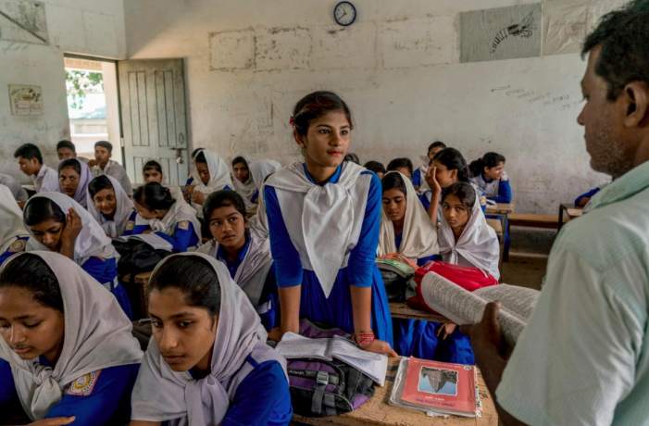
Social cohesion
Often not clearly defined. Fajth et al. (2019) define as combination of perceptions of safety in community; formal and informal social networks; trust within host community and towards different groups
While ‘Hunkering Down’ theory (Putnam) predicts increasing diversity will lead to withdrawal from collective life; Contact Theory (Allport) suggests where it provides opportunities for positive contact (esp. on equal terms), this can enhance positive attitudes to collective life
Empirical evidence is limited, and mixed. Fajth et al. (2019) challenge assumption that the presence of refugees damages social cohesion – note attitudes may change over time - possible to build close social relations and sustain a peaceful and inclusive social environment.
Notes:
https://www.nation.co.ke/news/The-making-of-a-Somali-capital-base-at-the-heart-of-Nairobi-/1056-1018208-tfmt47z/index.html
https://www.unhcr.org/news/stories/2018/8/5b3b6b964/new-support-refugees-helps-hosts-world-bank-official.html

Slide 14
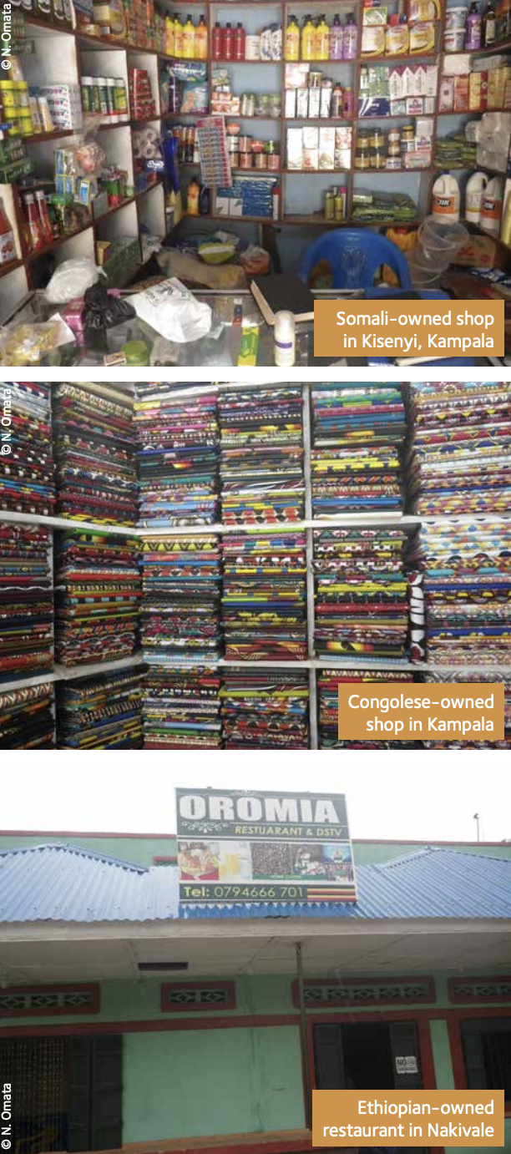
Services and broader development
Services – health, education – are often acutely overloaded and underfunded in refugee-receiving contexts – both within and outside organised refugee camps/settlements. Can lead to tensions between locals and refugees.
But broad effort to shift from ‘parallel’ services targeting refugees in camps only – to more integrated models, e.g. where locals can access camp services or where international support is given to expand local service provision.
Existence of large refugee camps in outlying areas and international attention often leads to investment in roads and infrastructure that might not otherwise have occurred.
Refugee presence can stimulate trade at markets within and close to the camps.
Inflows of aid money has multiplier effects (differentiated impact) and some of it may be allocated to projects intended specifically to support host community / foster constructive relations
Notes:
Refugee Economics Project – N. Omata photos

Slide 15
2. Policy approaches promoting self-reliance and wider development

Slide 16
Linking refugee relief and development?
Traditional division: humanitarian assistance urgent and short-term, development programmes more collaborative, longer-term: institutional policy silos
ICARA Process
1970s and 80s concern to promote greater refugee self-sufficiency AND address social and environmental impact of large refugee populations
International Conference on Assistance to Refugees in Africa (ICARA) in 1981 and 1984 aimed to get donors, international organisations and host governments to commit to more development-oriented approaches to refugee assistance.
But failed… Undermined by big new refugee crises occurring at the time. Host governments insisted on ‘additionality’, i.e. that any assistance agreed via this route should be additional to, not diverted from existing national development funding. Project ideas appeared self-serving rather than really oriented towards refugees’ needs.
International community did not step up to expectations in pledging support. And pledged funds politicised – ear-marked to support Cold War allies and strategic interests.

Slide 17
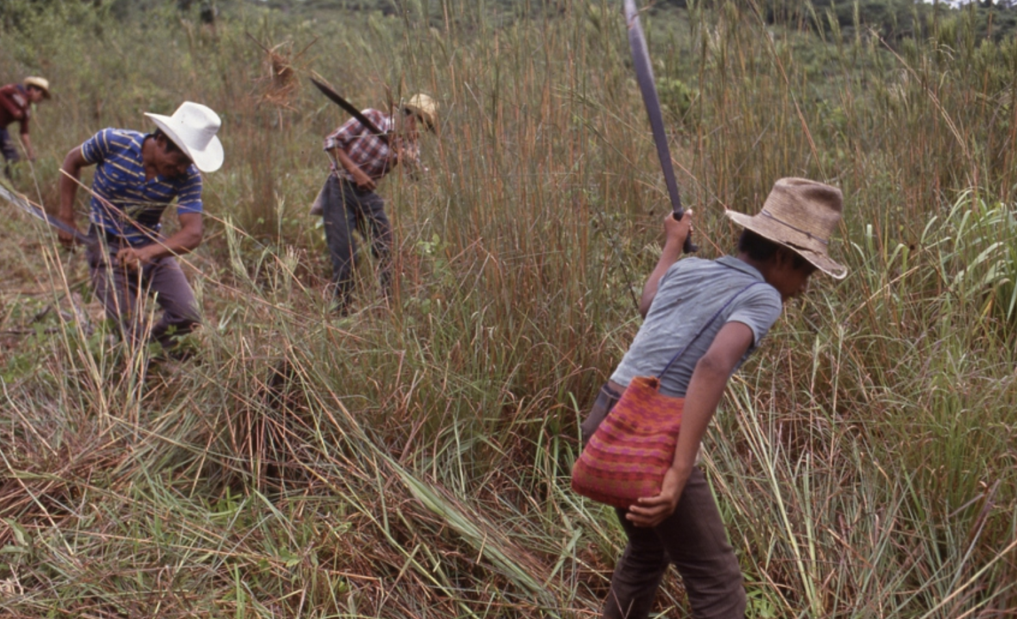
CIREFCA process
Late 1980s, early 1990s – wars on-going and ending in Central America (El Salvador, Guatemala, Nicaragua)
International Conference on Central American Refugees (CIREFCA) in 1989 launched a range of initiatives to bring the gap between humanitarian assistance and longer-term development.
Clear that in contexts of repatriation, sustainable peace depended on successful reintegration, rehabilitation and reconstruction
Simultaneous promotion, in some contexts, of local integration – Mexico saw it as a way to develop Yucatan Peninsula, poorest parts of the country
UNHCR and UNDP channeling assistance to communities where refugees were settling / returning
Including Quick Impact Projects: one-off, micro-projects. Modest funding, lots of community involvement and cooperation, addressing urgent needs e.g. rehabilitation of schools. Later model used elsewhere.

Slide 18
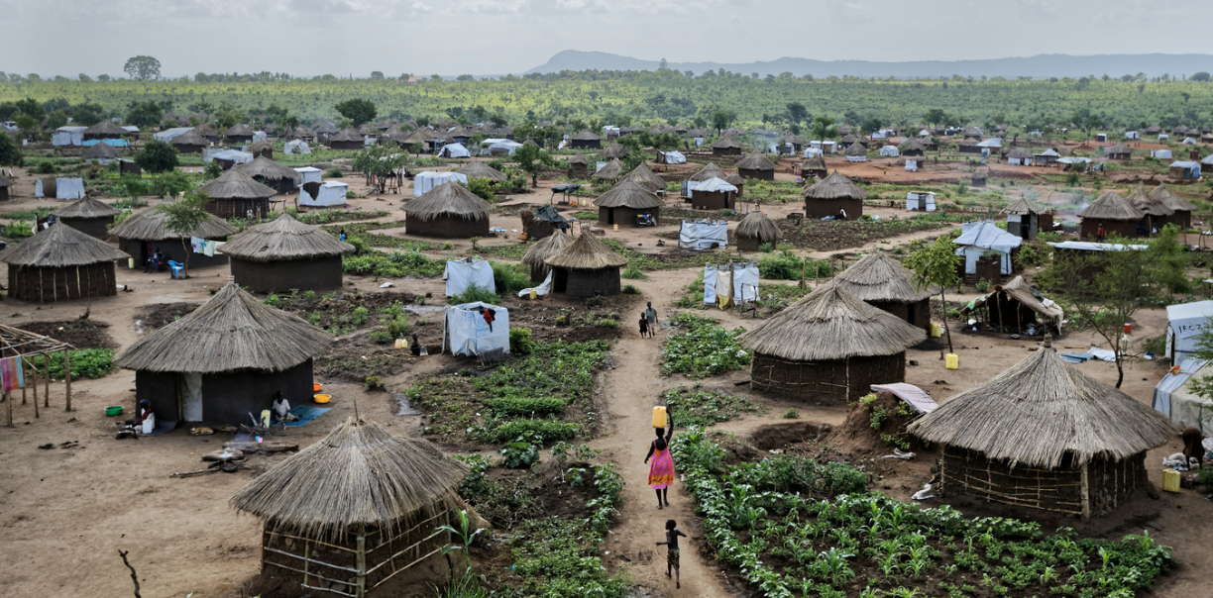
Uganda’s Self-Reliance approach
Long-standing policy approach of providing small plots of land for refugees to farm
Self-Reliance Strategy 1999-2003: all refugees o have access to land. Promote self reliance, service integration, phase out food aid
Context: needed to re-establish international credibility in wake of aid corruption charges; way of channeling resources & fostering development in Nile Valley area hosting Sudanese refugees
Results: SRS led to an increase in food production, esp. in fertile areas - refugee and local communities. Increased range of foods available. Integration of refugee children into primary schools. But withdrawal of food aid sometimes premature, quality of land variable, 4 year timetable over-ambitious. Lack of freedom of movement left many refugees in dire poverty, many moved to urban areas, informal, ‘invisible’ lives
Notes:
https://www.voanews.com/africa/un-1-million-south-sudan-refugees-now-Uganda [Bidi Bidi refugee settlement]

Slide 19
Since then: New Refugee Act 2006 allowed freedom of movement and right to work, although still face discrimination and informal barriers, research suggests refugees have higher incomes than in Kenya (more restrictive policies).
Politics: Uganda’s refugee policy widely hailed as exceptionally progressive, has boosted international reputation, secured support from donor states keen to contain displacement in regions of origin. But importance of addressing implementation problems. Note aid still basically settlement-based.
Durable solutionS? ‘amidst the growing focus on access to services and self-reliance, the idea of local integration and access to citizenship as a durable solution to the condition of protracted forced displacement has been virtually abandoned.’ (Hovil 2018)
Notes:
https://reliefweb.int/sites/reliefweb.int/files/resources/IRRI-Uganda-policy-paper-October-2018-Paper.pdf

Slide 20
Wider contemporary policy landscape…
‘Durable solution’ of local integration originally imagined as being about reconnecting refugees with rights of citizenship – 1951 Convention encourages states to consider ‘assimilation and naturalisation’ of refugees
But this depends in practice on the discretion and political will of the host state. In ‘mass influx’ situations, often there are concerns that the more secure the status provided, it will provide a ‘pull factor’, and lead to a large, permanent minority, affecting the domestic political landscape and tensions over work and access to resources with existing citizens.
Hence encampment remains a key approach: addressing needs of refugees, while keeping them separate. This has big implications for refugees’ livelihoods – often must reside in camps in order to receive humanitarian assistance, often face restrictions on their mobility.
Apart from basic humanitarian aid, livelihoods interventions have often tended to focus on inputs - seeds, tools, skills, microfinance – less political.
There is a growing political appetite for new ‘solutions’:
Host states: pressures & efforts to sustain international engagement
Extra-regional states: looking to shape development aid to stem migration
Growing interest of international development actors in refugee situations

Slide 21
Growing policy interest in fostering incremental, localised, informal integration and self-reliance among refugees
Broadening the frame: ‘displacement affected communities’ encompassning refugees, host communities and IDPs, linking to wider development challenges.
Going beyond sequential conception of relief then livelihoods – emergency then development
New field of engagement for development actors – World Bank, International Labour Organisation etc. New longer-term programmes and new finance platforms (government loans, social protection-style interventions).
Seeing more interventions that:
acknowledge and engage with urban refugees
acknowledge / encourage refugee enterprise
provision of work permits to refugees
negotiation of labour migration visas for refugees
interest in leveraging remittances..

Slide 22
3. Case study: the Jordan Compact

Slide 23
The Context
Jordan: a stable country in a troubled region, highly centralised government
Major economic challenges, low investment, high youth unemployment
Significant refugee presence, esp from Syria since 2011 (1m+)
90% outside camps
Unwillingness to admit Syrians long-term refugee population
Had to apply for work permits like other migrants (3,000 issued annually)

Slide 24
The Plan
Agreed in 2016, involving Jordanian government, donor states and humanitarian and development actors.
International community to provide humanitarian and development finance in the form of multi-year grants and concessional loans
Jordan to provide school places to all Syrian children
Jordan to issue 200,000 work permits to Syrians in specific sectors of the economy
Jordan to institute reforms to improve business and investment environment and formalise Syrian businesses
EU to relax trade regulations for 18 designated economic zones in Jordan, in return for employment quotas for Syrian refugees in the businesses benefiting
https://www.ilo.org/global/about-the-ilo/newsroom/news/WCMS_549276/lang--en/index.htm
TO DISCUSS: What are the strengths and weaknesses of the Jordan Compact – Thinking about:
The big idea/the overall model?
Nature of the policy process?
Impact?

Slide 25
Observations
Nature of policy process – a ‘political deal’ rather than an inclusive process. Cooperation of development and humanitarian actors. Strategic interests converged, but tensions within. Significant political momentum secured.
Issues in implementation – closed sectors, adjustments required to fit type of work allowed, relevance of informal sector to effectiveness, highly level of segmentation in labour market, refugees vs. migrant workers, trust issues, complex bureaucratic process to secure a work permit…
Impact – often measured in term of outputs, need to look at refugees’ socioeconomic indicators as well. School enrolment increased, but still 75.000 out of school (40%). Permits target not reached. Will it really deter onward movement as EU states hope?

Slide 26
Summary
Encampment persists as a dominant response, but fresh policy interest in engagement with refugee livelihoods and host communities and wider development processes
Hold potential to improve refugees’ lives, but work around rather than tackling fundamental predicament of being a refugee and the importance of legal rights and protection.

