Slide 1
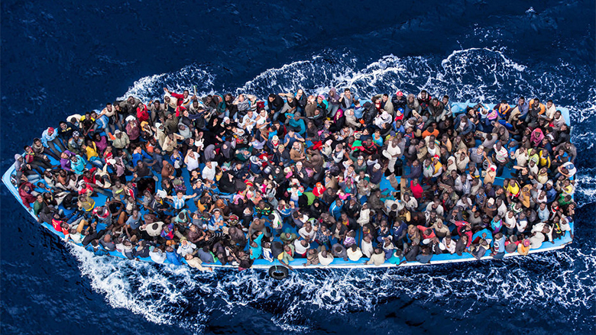
Introduction to Global Forced Migration studies
2019-20 week 2
The state producing displacement: from conflict to cumulative causation

Slide 2
Things to think about as we embark on the next FM ‘topic’
Where does knowledge come from?
How is it constituted?
From where does it get its authority?
Whose voices are included / excluded?
For Foucault, power and knowledge are not seen as independent entities but are inextricably related—knowledge is always an exercise of power and power always a function of knowledge (http://routledgesoc.com/profile/michel-Foucault)
Notes:
See also Gutting, G., 2005. Foucault: A very short introduction. Oxford, UK ; New York: Oxford University Press.

Slide 3
In this lecture
Refugee producing conflicts
Relations between forced migrants and states.
What prompts forced migration?
Displacement Case Study of South Sudan
Qs
What are the causes of forced migration?
How can we locate the ‘forced’ between structure and agency?
What is cumulative causation?

Slide 4
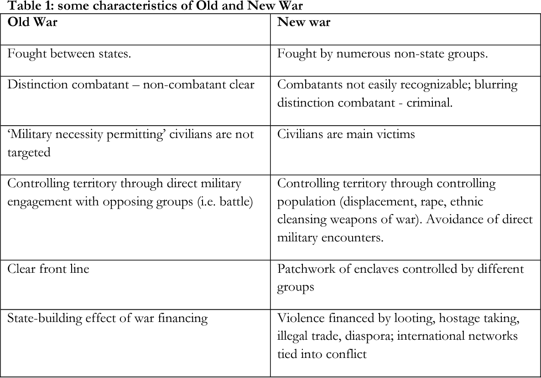
Rethinking armed conflict – how has conflict changed over time – with what consequences for FM?
Notes:
Rigterink, Anouk S.. “New Wars in Numbers. An exploration of various datasets on intra-state.” (2012).
Rethinking armed conflict
New wars
New Wars (Kaldor 2003): wars in the era of globalisation
Binaries of state/non-state; public and private, external/internal, economic/political breaking down
Mixture of war (organised violence for political ends), crime (organised violence for private ends) and human rights violations (violence against civilians).
A mutual enterprise to reproduce political identity and further economic interests
Mixing of aid, development and security agendas in the “age of liberal interventionism” (Duffield 2001).

Slide 5
Rethinking armed conflict
Case Study E.G. Afghanistan conflict - Binaries breaking down: actors are both state and non-state simultaneously (eg Ahmad Wali Karzai)
Mixture of:
War: Taliban and other insurgent groups organising violence for political ends; NATO and Afgh government retaliating with their own political ends
Crime: criminal gangs taking advantage of lack of rule of law to organise violence for private ends, but often can sell on hostages for political purposes
Violence against civilians, both intentional in terror attacks and in so-called collateral damage
A mutual enterprise to reproduce political identity and further economic interests: of the business elite, politicians, US contractors.
Securitsation of aid: PRTs and the killing of MSF staff in 2004
Notes:
https://www.newyorker.com/news/news-desk/death-of-an-afghan-godfather

Slide 6
Forced migrants and the state – reasons for flight get caught up in other political dynamics
WHICH ACTOR(S) ARE RESPONSIBLE FOR RESPONDING TO THE SOCIO-ECONOMIC, POLITICAL AND HUMANITARIAN NEEDS OF PEOPLE FORCIBLY BY
Conflict
Political persecution
Drought / environmental problems
Development problems
Food insecurity
Climate change related issues?
https://www.saferworld.org.uk/peacebuilding-responses-to-terrorism-and-migration/addressing-the-causes-of-forced-migration
Forced displacement is one of the defining global issues of our time. Worldwide, over 65 million people are displaced from their homes due to conflict, food insecurity, climate change and other threats. Current responses to the ‘migration crisis’ risk fuelling the problem. Destination countries for refugees and migrants are struggling with tensions and need support to respond in a way that deals fairly and effectively with different communities’ needs. Instead international support is focused on increasing states’ capacities to deal with displacement and migration forcefully rather than addressing the underlying drivers of conflict.

Slide 7
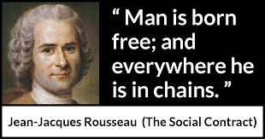
Individuals and states
Rousseau’s social contract between a state and its citizens. Premise that the state provides protection.
Citizen / foreigner
Insider / outsider
Enjoy rights / rights restricted
ASSUMPTIONS ABOUT THE STATE….?
Does this assume a strong, centralized state with a monopoly of violence?
What if the state is weak, or failing?
What if the state has no incentive to provide protection?
What if the state itself is contested?
What are the consequences of the involvement of external actors, including other states in a globalized world?
What are the implications of state / citizen relations of the transformation in conflict itself, since the end of the cold war?
Notes:
‘The Minorities Treaty said in plain language what until then had only been implied in the working system of nation states, namely, that only nationals could be citizens, only people of the same national origin could enjoy the full protection of legal institutions, that persons of different nationality needed some law of exception until or unless they were completely assimilated and divorced from their origin. (In the origins of totalitarianism 1951 p275) Arendt, Hannah

Slide 8
WHAT FUNCTIONS ARE PERFORMED BY THE STATE?
Sovereignty is not merely an empty concept, but entails the duty to represent and protect all those who fall within the sovereign jurisdiction of the state; a failure of the sovereign to fulfil these duties has the potential to produce refugees.
Refugees are therefore anomalies in the system of nation-states and challenge the assumption that all individuals belong to a territory. Indeed refugees do not fit into the citizen-state-territory trinity, but are forced, instead, into the gaps between nation-states. Accordingly refugees pose a problem for the international community quite different from that of other foreigners. Haddad 2002

Slide 9
Refugees challenge the meaning and integrity of the state
“In as much as the refugee, an apparently marginalised figure, unhinges the old trinity of state-nation-territory, it deserves instead to be regarded as the central figure of our political history“ (Agamben).
Refugees are an inevitable if unintended consequence of the nation state system; they are the result of erecting boundaries, attempting to assign all individuals to a territory within such boundaries, and then failing to ensure universal representation and protection. (Haddad 59-60)
Yet, they also have a function- as the ‘other’ they solidify in-group identity; and normalize the territorial rootedness of belonging by being presented and imagined as an anomaly (Malkki 1992)
Notes:
Refugees are threatening to a basic principle of international political organization—sovereignty. Thus “the main aim of the refugee regime continues to be then, the reestablishment of the refugee with a space of particularity, a territorial inside, a country of origin, represented and protected by the state, so as to restore normal order on life” (Haddad 2003).

Slide 10
Armed conflict and Forced Migration
“Forced migration is BOTH a threat to and a product of the international system of nation states” (Turton, 2002: 20)
In spite of the fact that wars have changed and are no longer limited to or defined by state/non-state binaries
The international state system is still very much intact and the dominant paradigm through which international relations are enacted and analysed
States are constantly trying “to reproduce themselves as viable and morally legitimate political communities…preserving the illusion that the ‘national order of things’ is also the natural order of things (Turton 2002: 20; Malkki,1992)
This is reflected in the way in which states respond to and even create forced movements of populations.
The dynamics of ‘New Wars’ make it unsurprising that the motivations and decision making criteria of forced migrants are likely to be mixed and complex.

Slide 11
Locating the ‘forced’ in forced migration
People make a choice to either remain in their homes or to abandon them:
People value their physical security and will relocate if they can if if they feel it is threatened
Movements will be continuous to some extent with previous experiences (Lubkeman)
People have expectations around future events
People compare status quo with their knowledge or expectation of how their life would be in location where they are considering fleeing to.
Importance of social networks in relaying information
Significance of cultural communities (Moore & Shellman 2004)
Notes:
“what characteristics make a country produce forced migrants?” Davenport, Moore and Poe (2003)
Bias in most studies focus on push factors rather than pull factors underscored by an assumption around the passivity of displaced people
People flee when the integrity of their person is threatened

Slide 12
Causes of flight
One longitudinal study (1971-1990) of refugee flows from 109 countries in the Global South (Schmeidl 1997) tested for three categories of factors that have been widely considered in the literature to influence forced migration:
Root/structural causes
Economic underdevelopment and population pressures
Proximate conditions
Political violence - governments with poor human rights record produce migration flows
Ethnic and civil conflicts also likely to produce migration flows
External involvement in conflicts - war by proxy
Interstate war
Intervening factors
facilitators of refugee flight: improved communication and transport links, family networks
obstacles to refugee flight: difficult geographic terrain, exit controls at the country of origin.

Slide 13
Structure and agency
The extent to which agency or structure prevails, remains a question of crucial importance in the analysis of migration processes:
The 1951 convention focuses on political, economic or social factors which forces people to move, but does not seek to explain their arrival in terms of their exercising agency: This may undermine their case for refugee status.
In contrast, migrants who are thought to have used illegal routes out of choice are easily criminalised and portrayed as a threat to societies.

Slide 14
Structure and agency
Class analysis
“A hierarchy of destinations” (Van Hear 2004)
“Power geometry of space-time compression” (Massey 1993), where the latter can be any phenomenon that alters the qualities of and relationship between space and time, or the relative spatial distances between places to appear to contract or grow closer (modern telecommunications, opening of market borders to ease trade) – the idea of the 'shrinking world'
“Some are more in charge of it [mobility] than others; some initiate flows and movement, others don’t; some are more on the receiving end of it than others; some are effectively imprisoned by it.” (Massey 1993: 61)

Slide 15
Cumulative causation
Conditions which initiate migration are different from those which perpetuate it across time and space
Development of migrant’s social networks and institutions facilitating transnational movement results in a process called cumulative causation (Massey et al. 1993)
Growth of migrant networks mitigates risk involved in migrating and diversifies risk for those who remain behind.
Causation is cumulative because each act of migration alters the social context within which subsequent migration decisions are made

Slide 16
Lecture summary: the State producing
displacement?
General assumption that predatory, strong state produces migrants – forces migration on the basis of structural discrimination against certain groups, persistent oppression etc – ROOT CAUSES
But these can continue for many years, or forever, without producing mass migration. Many states have these without displacement. Root causes combined with PROXIMATE causes – ethnic cleansing, riots, war – are more likely to produce displacement
But also that a weak or 'failed' state also produces migration through lack of protection of civilians against violent insurgency, or lack of social provisions
AND that international intervention can directly influence state policy (esp. in weak states) and contribute to migration eg through structural adjustment and neoliberal ideology (Marfleet 2007).

Slide 17
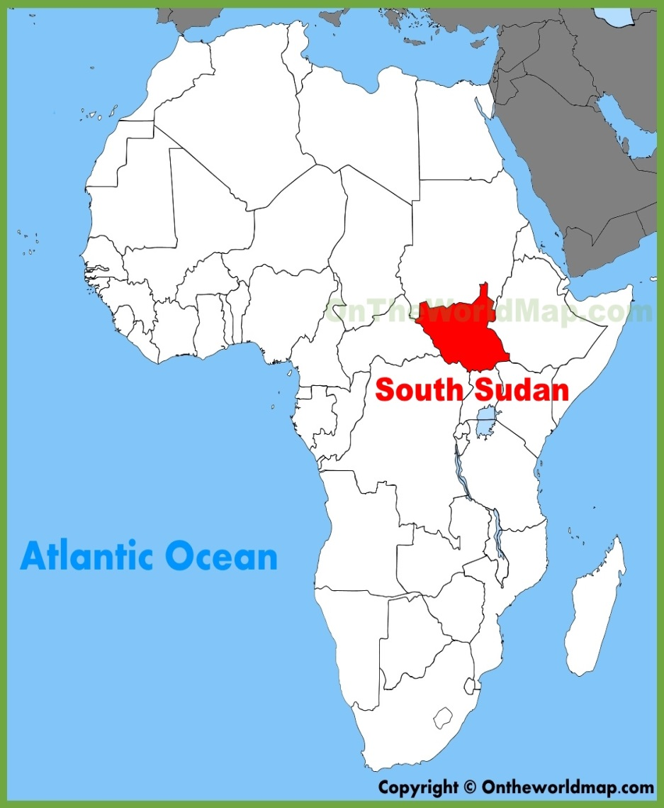
Conflict, displacement and States:
South Sudan
Numerous states involved: South Sudan, Sudan, Ethiopia, Uganda, Kenya…and more
International relations crucial to the generation, reception and treatment of refugees – and this subject to changes over time.
Borders and boundaries; internal borders are also important –not least because inter-ethnic fighting is productive of IDPs and refugees
Where to run? South Sudanese displaced may head away from the nearest international border, and head instead for Juba.

Slide 18
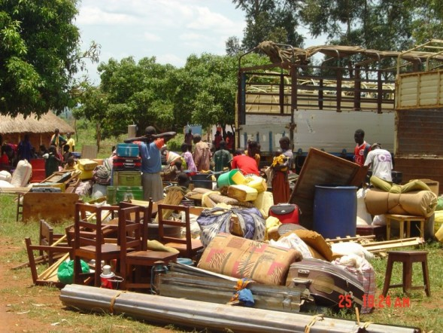
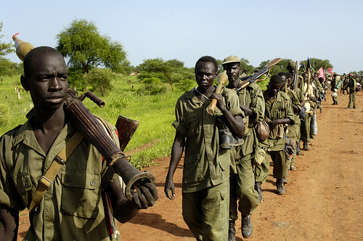
HISTORY OF CONFLICT(S) SOUTH SUDAN
Colonial War
Liberation struggle – ind 1956
Internal conflicts
Peace agreement 2005
Independence 2011followed by…
Dec 2013 more internal conflict between different groups
Contest over control of the state
Huge civilian costs; death, displ, impoverishment
Famine again declared in South Sudan Feb 2017
Peace agreement signed 2018, Riek Machar returns to South Sudan. Further violence
380,000 est dead since 2013, + reports of massively inc sexual violence
2018 Peace Agreement signed. We wait.

Slide 19
South Sudan UNHCR 2018
https://www.unhcr.org/partners/donors/5a8147777/2018-south-sudan-regional-refugee-response-plan-january-december-2018.html

Slide 20
Notes:
OCHA Sept 2017

Slide 21
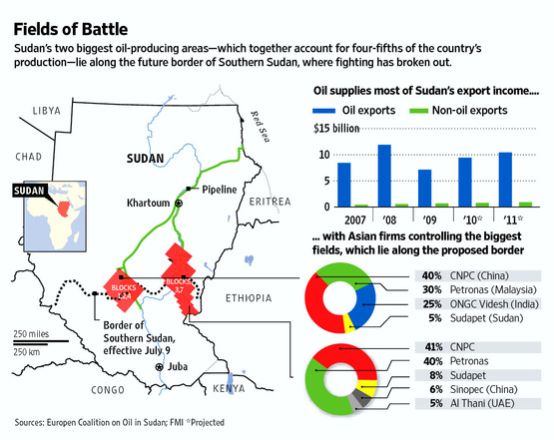
Immediate reasons for violence in the recent past?
Struggle for control of the state
Border disputes
Contest over Oil resources and revenues
Power struggle between ethnic groups
Other local conflicts

Slide 22
UNHCR South Sudan 2019

Slide 23
Q: Are things just more complicated now?
What is a refugee if there is no nation-state? Can refugees really exist as a category if there are no effective governments in control of territory and the mass illusion of real democracy has faded away? Today’s refugee is a person seeking multiple refuges, not only from political violence but also from neoliberalism, a system that erodes every border to create ceaseless capital flows while erecting new walls to separate humans.
http://creativetimereports.org/2014/02/03/what-is-a-refugee-if-there-is-no-nation-state-palestinian-syrian/

Slide 24
Exercise:
Choose a case study country/region and think about the following:
What are the root causes of FM?
What are the proximate causes? How do they combine with root causes?
Are there weak/fragile/failed state dynamics to consider?
What about international intervention as a contributor towards FM here?
What about cumulative causation?

