Slide 1
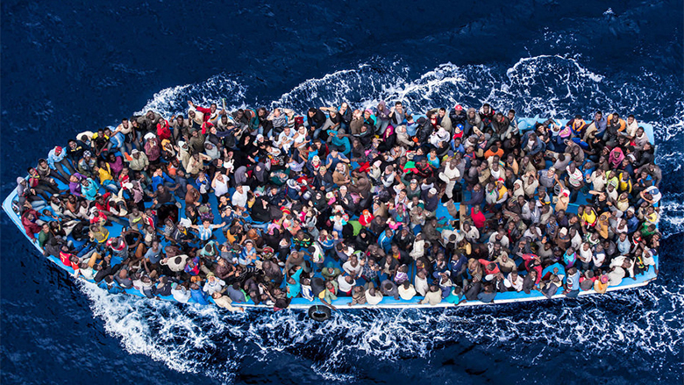
Introduction to Global Forced Migration studies
2019-20 week 1 concept and scope of Forced Migration Studies
Notes:
The module begins by posing some questions which will underpin the topics to be covered as it progresses. What does it mean to study forced migration? If one does so from the privileged position of an elite Western academic institution, how does this shape the kinds of questions which are asked and the kinds of materials offered in evidence for arguments made and positions held? What would it mean in this context to "decolonise" the study of forced migration?
How has the study of forced migration been shaped over the last half century or so? What are the definitions notably of the different kinds of forced and other migrants? What are the conditions that generated them? What has been the role of the sending state and the hosting state when dealing with forced migrants? What do we mean by ‘refugee cycle’? A consideration of key terms: flight, exile and the search for ‘durable solutions’

Slide 2
WHAT IS THE MODULE ‘ABOUT’?
Taking a critical, interdisciplinary approach
    Global patterns and dynamics of FM
    Socio-economic impacts of FM on local, national, regional and global spaces
    Theoretical and policy-based approaches
    Processes and patterns of displacement, exile and return

Slide 3
THE DISPACED AND THE DEVELOPMENT PROCESS
LAW
POWER AND POLITICS
THE ROLE OF THE STATE
DURABLE SOLUTIONS?
AID AND HUMANITARIAN INTERVENTION
FORCED MIGRATION IN
ALL ITS FORMS
DEMOGRAPHY
REFUGEES AND IDPS
IR
RESISTANCE AND AUTONOMY
GENDER AND GENERATION
CATEGORIES AND LABELS : CONTROL AND CONTAINMENT
DECOLON-IZING FORCED MIGRATION STUDIES?
HISTORY
INTERNATIONAL REFUGEE LAW
LIVELIHOODS AND ECONOMIC SURVIVAL
DISPLACED SUBJECTIVITIES
PROTECTION OF FORCED MIGRANTS
ANTHROPOLOGY
DID / ENVIRONMENT
GEOGRAPHY

Slide 4
LEARNING OBJECTIVES
Critical understanding of refugee definitions, other displacement categories & their impact
Critical understanding of international legal protection, development and humanitarian assistance frameworks for refugees & the displaced
Knowledge and understanding of the political, economic, social and cultural impact that migrant communities are having in a world of global movement
Critical appreciation of the political, economic, social and cultural dynamics and experiences of displacement
Illustration of these issues with reference to developing world cases and to European asylum systems

Slide 5
WHAT SKILLS CAN I EXPECT TO LEARN/DEVELOP?
READING SELECTIVELY AND STRATEGICALLY
ASSESSING AND ANALYSING A WIDE RANGE OF INFORMATION SOURCES
SKILLS OF CRITICAL ENGAGEMENT AND ANALYSIS
APPLYING THEORETICAL / ANALYTICAL PERSPECTIVES TO EMPIRICAL MATERIAL
LEARNING ABOUT A WIDE RANGE OF CASE STUDIES AND HOW TO DEEPEN UNDERSTANDING OF THESE BY USING ACADEMIC TOOLS

Slide 6
In today’s lecture
SNAPSHOTS OF FORCED MIGRATION CONTEXTS – HOW DO THESE CONNECT TO THE THEMES AND APPROACHES OF THE COURSE?
SCALE AND DIVERSITY OF FORCED MIGRATION GLOBALLY
ANALYTICAL APPROACHES, A STARTING POINT
DISCOURSES OF FM
DECOLONIZING FM?

Slide 7
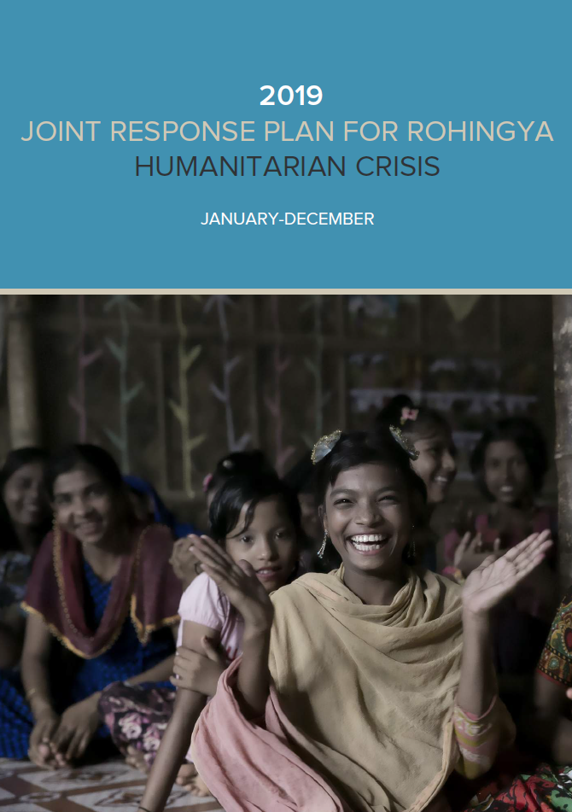
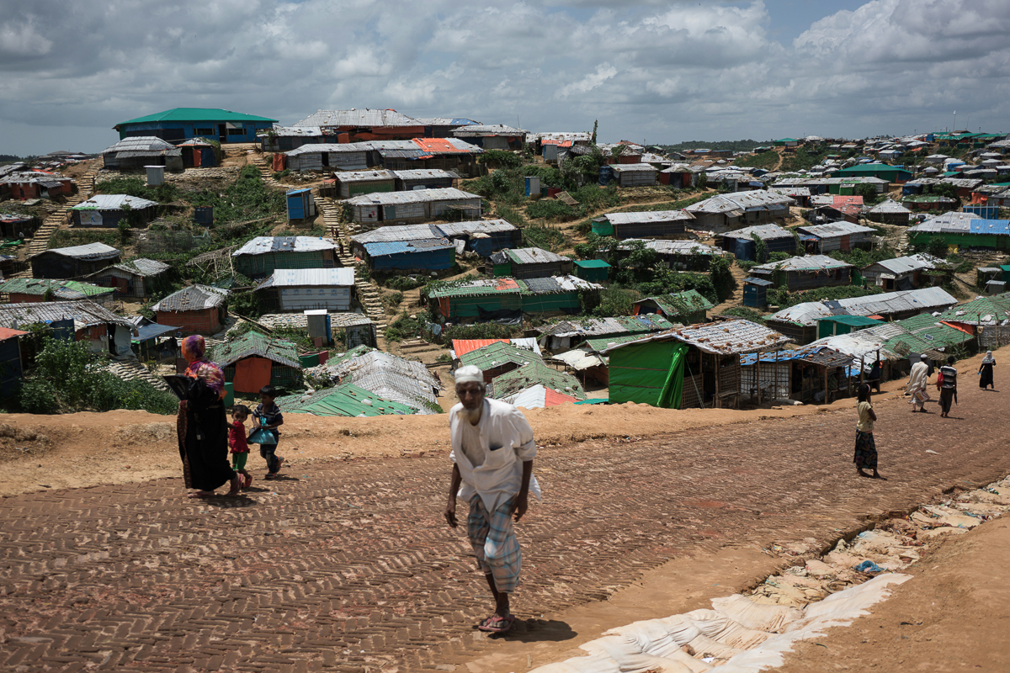
Complexities of forced migration
Rohingya refugees in Bangladesh
https://www.unhcr.org/uk/rohingya-emergency.html

Slide 8
Numbers of ‘forcibly displaced people’ worldwide?
Hosts with highest numbers of refugees?
Numerically? Relative to home population?
Three main ‘sending states’?

Slide 9
Global Forced Migration by End 2018 (UNHCR Global Trends Report 2019)

Slide 13
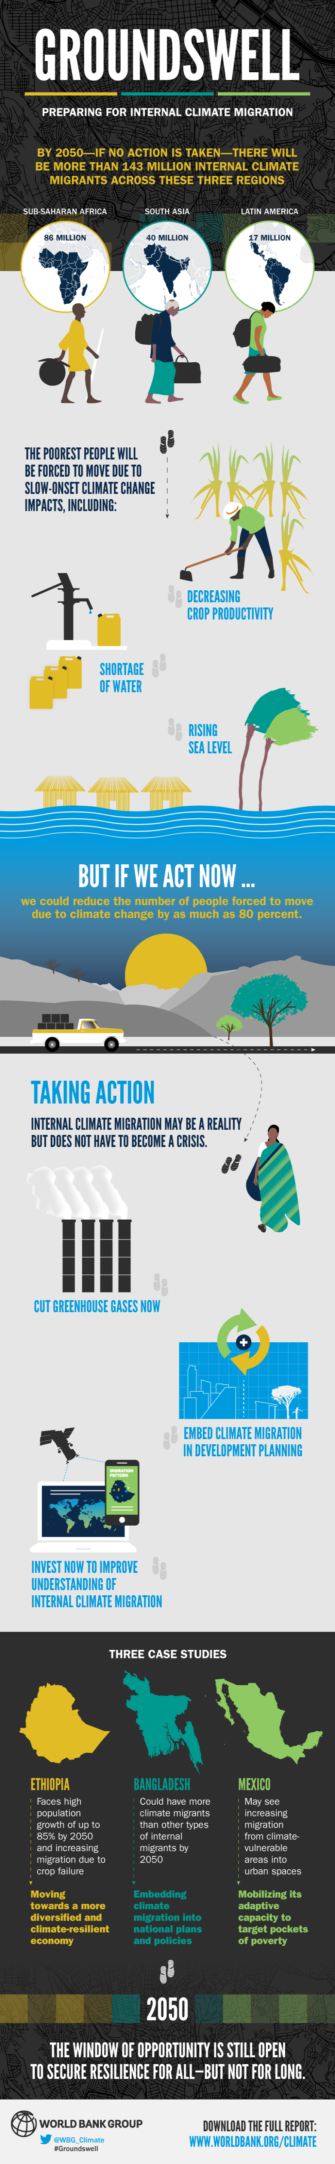
World bank Report 2018 ‘Groundswell’ on Prospects of Climate Migration by 2050

Slide 14
IDMC 2019 – Global IDPs

Slide 15
Refugee cycle
violence, persecution and flight, as a cycle in itself – but also one that is 'completed' with the return home of refugees.
'Durable solutions’:
1) voluntary repatriation
2) local integration in the country of first asylum
3) third country resettlement / resettlement elsewhere
Considered durable solutions because they point to the closure of the refugee cycle and an end to refugee suffering, aid dependence, and need for international protection.

Slide 16
key questions emerging from ‘the facts’ throughout
  Who is a refugee and how has this category been constructed?
  What are the global, national and local dynamics of flows of refugees and IDPs?
  How does the international refugee regime approach the changing nature of these movements?
  How appropriate are existing theoretical frameworks for analysing refugeehood and displacement?

Slide 17
History?
Sedentarist assumptions? History: How FMS emerged
Large scale refugee movements: not new, eg many mass migrations caused by religious persecution in Europe 1400-1700
But only became an international political problem in the twentieth century (Elie 2016)
“The task for a contemporary sociology of forced migration is to analyse the new characteristics of forced migration in the epoch of globalization” (Castles 2003: 18)

Slide 18
1. History: How FMS emerged
Key points:
1) Relationship between Refugee/FM Studies and northern government policy: close but contentious
2) Structural inequalities between global north and south: shape refugee movements themselves and also the discipline that studies them
3) Tension between conducting research for academic purposes and conducting research to (attempt to) change lives: both problematic

Slide 19

3. Sending state, host state
In spite of the problems making clear-cut distinctions between categories of people, there is considerable difference between a migrant and a refugee – because the latter reflects the dissolution of the state-citizen relationship and where ‘someone is out to get you’ – BUT, processes and conditions of migration and displacement overlap (Bakewell 2011).
Increasingly securitised approach to asylum seekers by potential host states in the global north – entry becoming more restricted since 1980s and particularly since 9/11 in spite of the fact that none of the perpetrators were refugees or asylum seekers
‘ Containment' policies promoted by global north actors in the global south – including aid (and work towards the prevention of flight), camps, repatriation, campaigns against migration, and military intervention
Reflect structurally unequal north-south relations more generally

Slide 20
Discussing the discourse
Normative discourse very much northern-defined, and 'othering’:
Pervasive metaphor of liquid, spoken from a state-centric and sedentary perspective – “the language we use to talk about them” as an “undifferentiated mass” (Turton, 2003, 4-5, emphasis added)
Attempted distinctions made – forced/voluntary migrants, forced/economic migrants – very common but unhelpful and inaccurate as reasons for migration are almost always multi-faceted.
The asylum-migration nexus: “many migrants and asylum seekers have multiple reasons for mobility and it is impossible to completely separate economic and human rights motivations – which is a challenge to the neat categories that bureaucracies seek to impose.” (Castles 2003, 17)

