Slide 1
Becoming an entrepreneurial leader (Burns book – chapter 4)
22nd Oct 2019

Slide 2
Introduction
‘Entrepreneurial leadership or what we term strategic entrepreneurship, is described…as the main resource in an organisation’ (Stokvik et al, 2016:350).

Slide 3
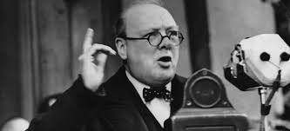
Role of the leader – Burns pp100-101
For Burns (2013:100), leaders are ‘special people’ or ‘charismatic heroes’ like Winston Churchill’ – they must be a designer and focus on:
‘Having a vision for the organization’ – values, goal setting.
‘Being able to develop strategy’ – vision, analysis, options.
‘Being able to communicate’ – inspire, motivate, publically perform.
‘Creating an appropriate culture’ – artefacts, symbols, rituals.
‘Managing and monitoring performance’ – freedom and control.
also see (Blank, 1995; Zaccaro, 2007)

Slide 4
Building a shared vision – Burns pp102-104
As Burn’s (2013:102) stresses, vision refers to the communication of ‘a shared mental image of a desired future state’ (also see Alvesson and Willmott, 2012; Bartlett and Ghoshal,1994; Chia and Holt, 2009).
Like Senge (1992), Nahapiet and Ghoshal (1998:253) suggest a meaningful vision is achieved ‘through the existence of shared language’ i.e. technical lingo etc.
Also, like Gardner (1995), Nahapiet and Ghoshal (1998:253) emphasise the importance of ‘sharing collective narratives’ i.e. stories, myths etc.
(also see Kotter, 1996).

Slide 5
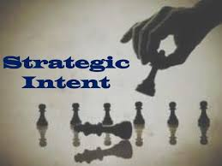
Strategic Intent – Burns pp104-105
For Ohmae (2005), the Japanese word kosoryoku implies evolving strategic formulation in the age of uncertainty (also see Fukuyama, 1995 and the end of order).
Evolving towards ‘Blue Ocean’ strategy helps to avoid stagnation (Kim and Mauborgne, 2005).
Both Hamel (2000) and Prahalad and Hamel (1990) stress the importance of the following in creating strategic intent: (1) customer benefits; (2) customer interface; and (3) competencies-wealth potential.

Slide 6
Core personal attributes of leaders – Burns pp105-107
‘Self-awareness’ – the ability to understand yourself and your emotions.
‘Self-management’ – control, personal responsibility, initiative.
‘Social awareness’ – empathy, sensitivity, respectful, fairness.
‘Social skills’ – expressiveness, ingratiation, self-promotion, assertiveness – are crucial for relationship building and ‘no longer a nicety or a coping mechanism, instead it is a leadership imperative’ (Blass and Ferris, 2007:11).
(also see Baron and Markman, 2000, 2003; Baron, 2007; Chell, 2013; Cornelissen and Clarke, 2010, 2011; Westphal, 2010; Zott and Huy, 2007)

Slide 7
Leadership paradigms – Burns pp114-117
‘Transactional leadership’ – this refers to traditional planning, controlling, monitoring and rewarding individuals (Bass, 1985, 1998; Rozzell and Gundersen, 2003).
‘Transformational leadership’ – this refers to charismatic leaders being role-models and empowering (Avolio, 1999; Sosik et al, 2002).
‘Visionary leader’ – this refers to a flexible individual that is clearly focused, communicates effectively and invests time in others (Kuratko, 2009; Sashkin, 1996; Wickham, 2006).

Slide 8
Leadership style – Burns pp107-113
‘Authoritative [autocratic-exploitative] style’ – direction and decision-making reflect traditional status attainment and power-control (see Avolio and Gardner, 2005; Bass and Avolio, 1990).
‘Democratic [consultative] style’ – prioritises group decision-making process and reflects consensus building and team-building (Hargie et al, 1994).
‘Laissez-faire’ – openness and freedom are encouraged, there is little direction and few formal boundaries (Hargie et al, 1994).

Slide 9
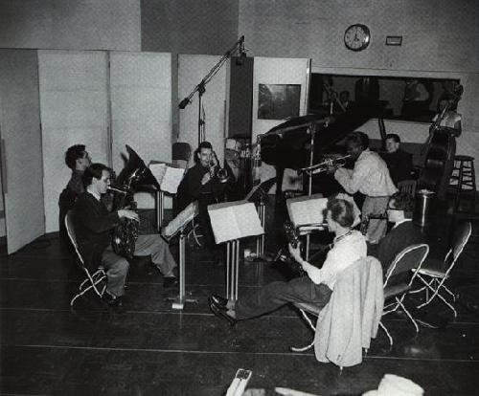
Entrepreneurial leadership in focus – Burns pp114-120
In a study of Jazz bands, Ucbasaran and Lockett (2012:2) point out ‘Do not fear mistakes. There are none. Miles Davies is credited with saying…If entrepreneurial leaders want high levels of creativity from their team, they must accept that sometimes things will go wrong. The jazz leaders embraced mistakes as part of the process of creating something new and valuable’.

Slide 10
Entrepreneurial leadership in focus cont. – Burns pp114-120
Like Kuratko (2009), Burns (2013) stresses the importance of the following:
‘visionary-revolutionary’ – values, self-direction.
‘good communicator-motivator’ – shared mental models, able to motivate.
‘strategic thinker-learner’ – strategic analysis, strategic options, strategic intent.
‘emotional intelligence-network builder’ – adaptive, interpersonal skills, networked.
‘team player’ – delegation, adopt different multilevel roles.
‘builder of confidence-empowering’ – self-efficiency, rewards.

Slide 11
To conclude:
‘Entrepreneurial leadership may be practiced by many people in an organisation, and consists of persons who alone, or together with others, create the ‘hot spots’ in organisations’ (Stokvik et al, 2016:350).

