Slide 1
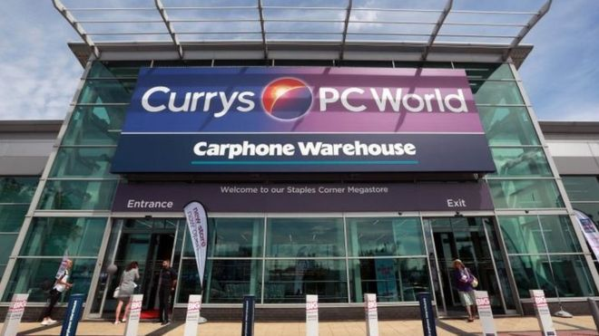
MK9701: Portfolio Guidance

Slide 2
Component Two:

Slide 3
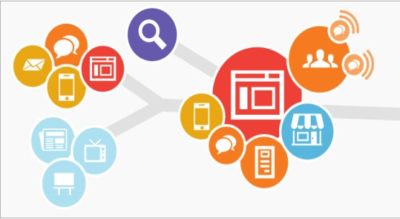
Suggested Portfolio Format
The work will be submitted via Turnitin on the MK9701 Blackboard site
There will be three separate folders for each task
It is best to submit work in PDF format
Please ensure you provide one combined reference list for all tasks as part of task three

Slide 4
A note on the word count:
The 2,000 word limit (+/-10%) only applies to part three of the portfolio
All content in part one does not contribute towards the word count
Please declare your part two word count on your title page

Slide 5
Part One: Infographic
You are required to produce an infographic which provides insights on:
Your chosen target market
Your chosen product category
You will use secondary research to develop a professional standard document which will provide both a detailed understanding of the customer and identify trends in the product category.
What are we looking for in both documents?
A range of segmentation criteria used that are relevant to the product category
Good use of credible, supporting research
Professional presentation

Slide 6
Part One: Infographic (cont)
An infographic is a visual means of communicating key knowledge on a subject (in this case the target market)
Your role is to decide on the key facts / figures / knowledge you have on your target market, and present them professionally through an infographic
Remember this is not just about your persona, but the wider target market for your chosen product category
No need to create one from scratch – there are many websites out there to help you with templates (e.g. Canva)
Please ensure that sources are cited!

Slide 7
Part 2: Database Activity
This section is testing your ability to use a piece of industry software to:
Handle data
Segment audiences based on set criteria
Design tailored messages to each group
We are now assuming that customers have bought something, are on the Currys PC World database and can influenced into extended their relationship with them

Slide 8
Database Work: What to Include
Email Marketing Plan
Screenshots of:
How you have manipulated the data
How you have segmented the database
Output email for each segment

Slide 9
Database Work: The Plan
You will be provided with an email marketing plan template which will cover:
How you will segment your database in the Websand software
What your objectives are for each segment
How you intend to tailor your message for each segment
This is the first thing you will include in your database section

Slide 11
Database Work: Your Objectives
Your objective may or may not be about achieving another transaction
General
To generate awareness
To inspire need
To inform
To persuade
To encourage action
To educate
To remind / refresh
To entertain
To compare alternatives
To change attitudes
To satisfy
To retain
Digital Specific
To drive site traffic
To increase social followership
Customer Engagement
To convert leads
To accrue customer data
To drive online users in-store
To handle customer queries
To engage lapsed users
To generate sharing behaviour
To develop user generated content
To support other marketing efforts
To improve sentiment

Slide 12
Database Work: Data
Your first role is to get hold of the data and make any changes you wish to personalise it to your case (future communication from Saul will explain what you can and cannot change)
Please note: you are not permitted to add any further columns to the data as this would result in a far more complicated process
Once this is complete then you follow the process for uploading this to the Websand system (covered on the walkthrough which will be provided / covered in class)
Please note: once your import your data it may take up to 12 hours to appear on your dashboard
Include 2-3 screenshots to demonstrate your work here

Slide 15
Database Work: Segmenting
You are then required to use the segment ‘function’ to create segments for the email marketing activity
You can create segments based on either:
One criteria (follow the walkthrough instructions)
More than on criteria (to do this, you need to create segments for each individual segment, and then use the combine segments function to bring them into one segment)
You may create between 3-4 segments
Include 2-3 screenshots to demonstrate your work here

Slide 17
Database Work: Message Creation
Once you have your segments you are required to build a separate email for each segment designed to meet your set objectives
The walkthrough will provide detailed guidance on how you can create, amend and send test messages
Take time to consider how you will differentiate messages across each segment
We expect a clear and professional layout that conforms broadly to Currys PC World style

Slide 19
Database Work: Marking Criteria
Creation of distinct customer segments based on suitable data fields
Setting of clear objectives for each customer segment
Development of targeted email communications designed to achieve the stated objectives
Competent usage of database software with suitable screenshots included to showcase work

Slide 20
Part Three: Reflective Statement of Learning
For this section you are required to select one of the below topics:
Online Consumer Behaviour
Customer Journey Mapping
Database Marketing
Use academic or practitioner sources to demonstrate your understanding of the concept
Include a critical reflection of how these concepts are useful (or not!) to digital marketers, and specifically your case study
Please do not simply say why your chosen topic is positive / useful – try and be two-sided

Slide 21
End of Panopto Slide
*Include generic wrap up message*
*Mention that the best beer to bribe you with is Moretti or Tiger*
*Say something derogatory about Kirk or Ronnie*

